Slide 1
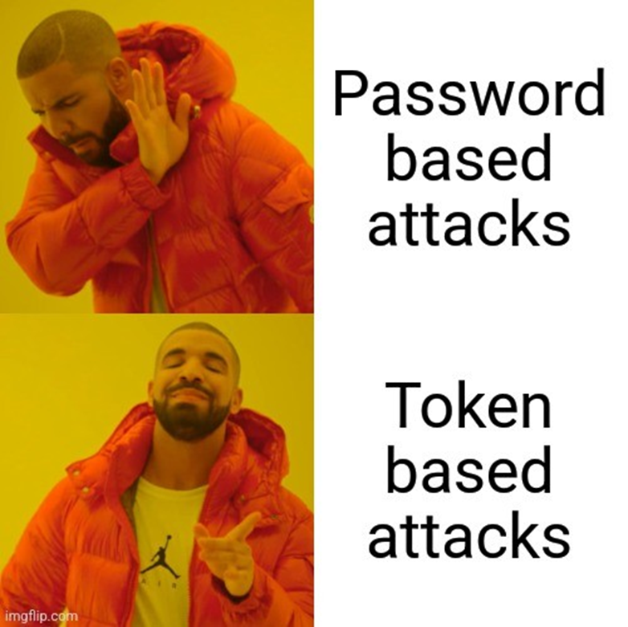

So you’ve got MFA? Defending and Responding against MFA Bypass techniques in Entra
Jay Kerai (Cyber Automation Architect at SCC) Aka Devfender
https://www.linkedin.com/in/jay-kerai-cyber/
https://github.com/jkerai1
August 2024 - M365 Security & Compliance User Group, Wed, Aug 28, 2024, 6:00 PM | Meetup

Slide 2
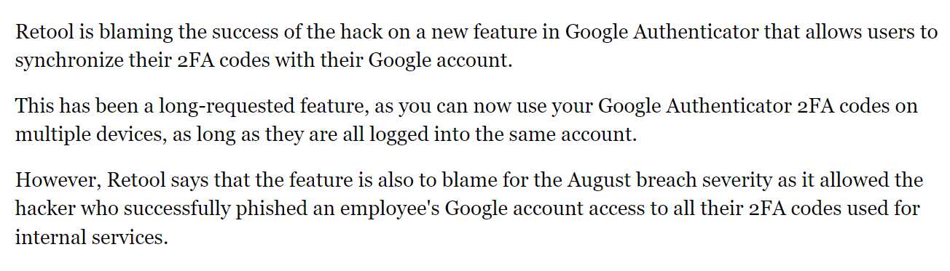
How did we get here?
Initially password only
Password + “weak” MFA
Password + One Time Code (offline)
Password + Push Notification
Password + Number Matching MFA
FIDO?
We cannot solve our problems with the same thinking we used when we created them.
Notes:
Users cant be trusted to set secure passwords
Rouge Carrier, SMS sim swap, SMS encrypted

Slide 3
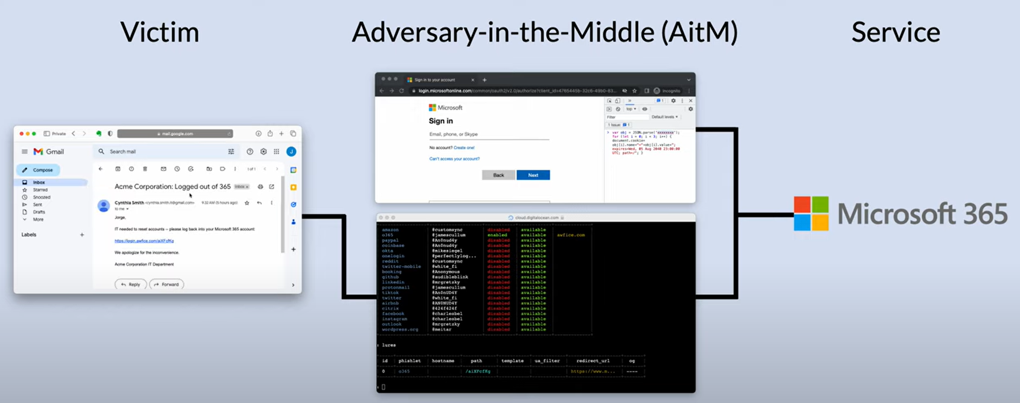
AiTM is the new defacto phishing method!
How to bypass MFA?
This talk will be heavily focused on Reverse Proxy Phishing aka. Adversary in the middle (AitM). Examples include Evilginx2/modlishka
Ref: https://github.com/kgretzky/evilginx2 /
Notes:
Video: MFA AitM Attack (youtube.com)
Notes on the URL
1) Attackers like to do path/query to hide from scanners,
2) Attackers also like to do tokenized “burn once” urls to prevent blue team detonating
3) don’t get full path and query in MDE logs unless goes via smartscreen/Exploitguard so may need to live response and pull browser history from device
4) Attacker can prevent detonation by IP/user Agent/referrer. By default block redirect is a rick roll in evilgnix
https://github.com/drk1wi/Modlishka
DeviceEvents
| where ActionType == "SmartScreenUrlWarning" or ActionType == "ExploitGuardNetworkProtectionBlocked"

Slide 4
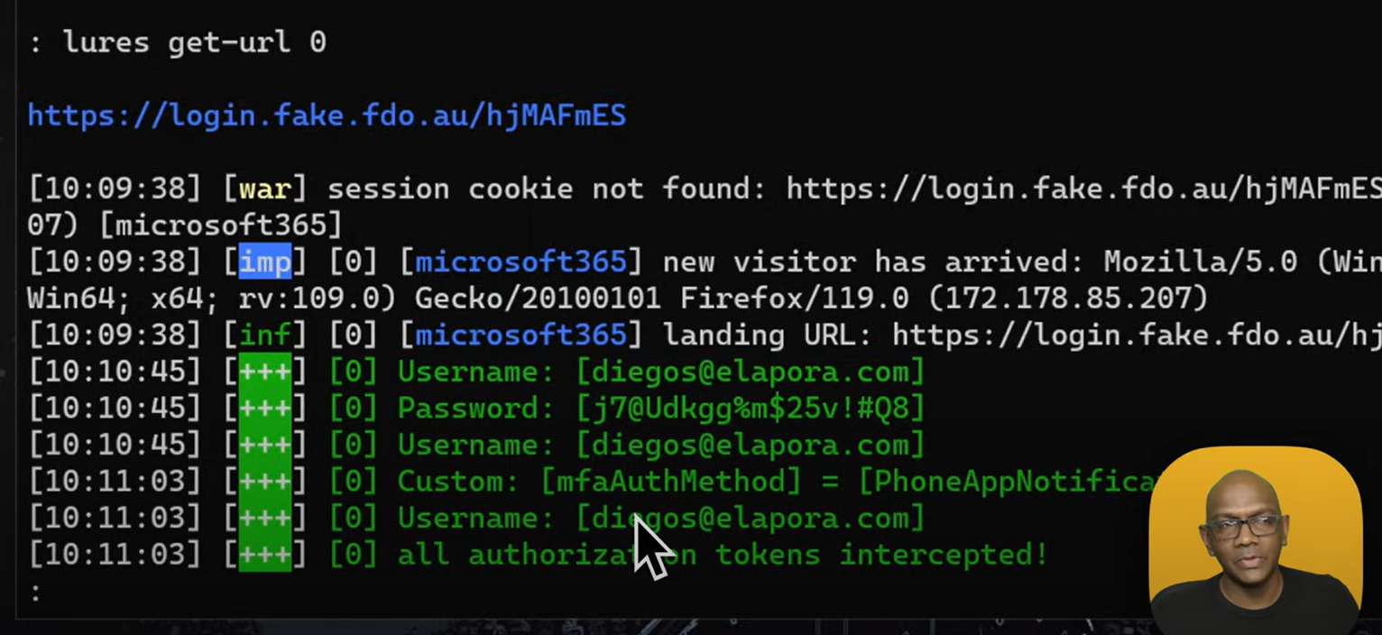
“Bypasses” Number Matching too!
While SMS was demonstrated, can bypass number matching/Passwordless MFA (not to be confused with Passkey/FIDO) too
Though Microsoft Authenticator does sometimes suppress malicious MFA prompts
Notes:
Passwordless MFA defeated in same way, user is just not prompted for password first
Stop hackers from stealing your Microsoft 365 user's passwords - YouTube

Slide 5
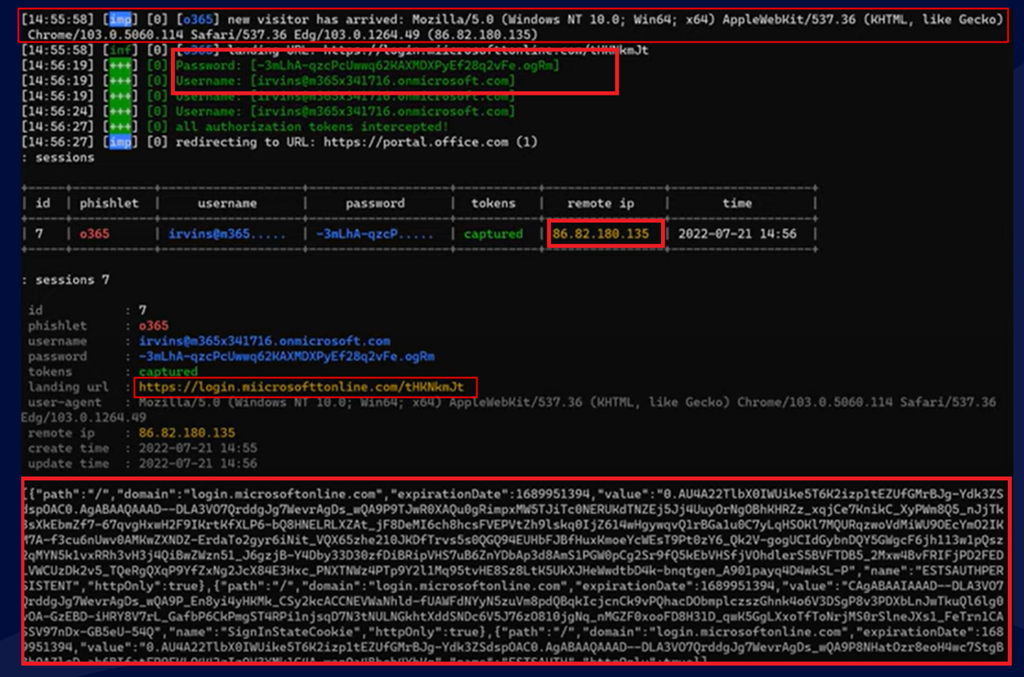
Closer Look At Evilnginx2 Output
Super strong password still defeated!
Cookie is the set of {Access and refresh token}! Refresh Token provides seamless experience to the user after access token expires (~60mins - ~90 mins). I.e refresh access tokens without user reprompt.
Notes:
There's actually other artifacts in there too but lets ignore them here as they aren’t important for understanding AITMs

Slide 6
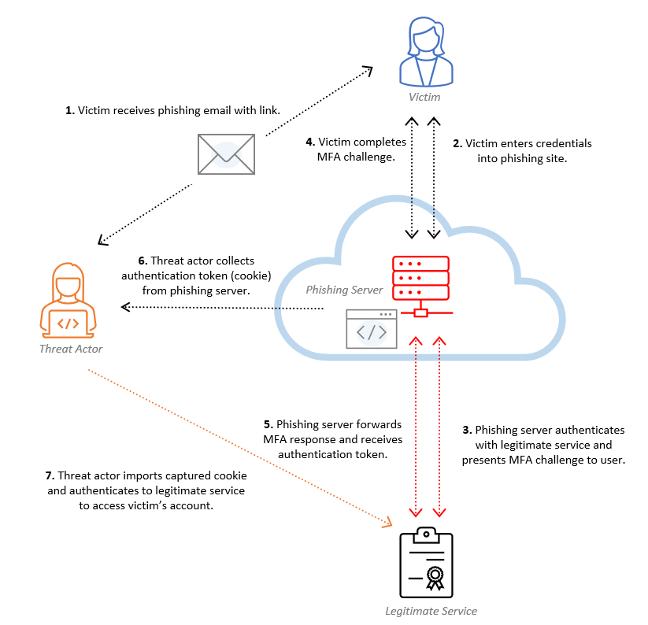
Simplifying the Attack
Think of it as tricking user into generating us a token rather than token theft
This is not like network-based MiTM attack involving ARP/DNS/DHCP etc. not discussing these in this talk
Many other cool things evilginx does under the hood which won’t be discussed in this talk (EvilPuppet, Cookie manipulation, built-in DNS server, lure hiding, HTTP modification, certificate autorenewal etc.)
Notes:
https://www.microsoft.com/en-us/security/blog/2022/07/12/from-cookie-theft-to-bec-attackers-use-aitm-phishing-sites-as-entry-point-to-further-financial-fraud/

Slide 7
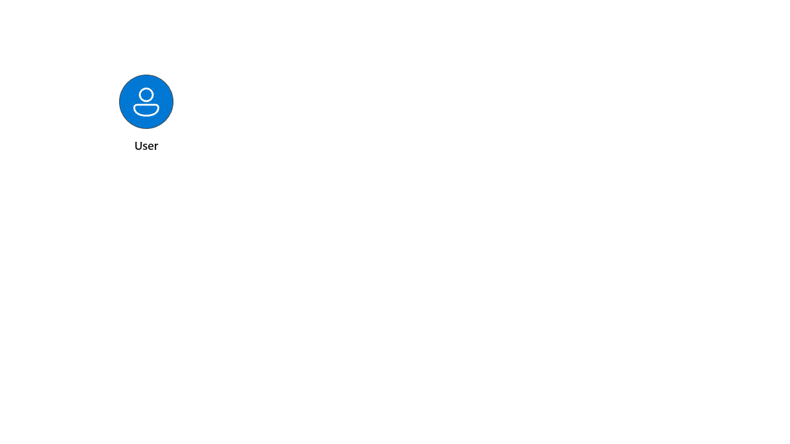
Contrasting Classical Token Theft with AiTM
Ref: https://techcommunity.microsoft.com/t5/microsoft-entra-blog/how-to-break-the-token-theft-cyber-attack-chain/ba-p/4062700
Notes:
Won’t cover network based token Theft as well known

Slide 8
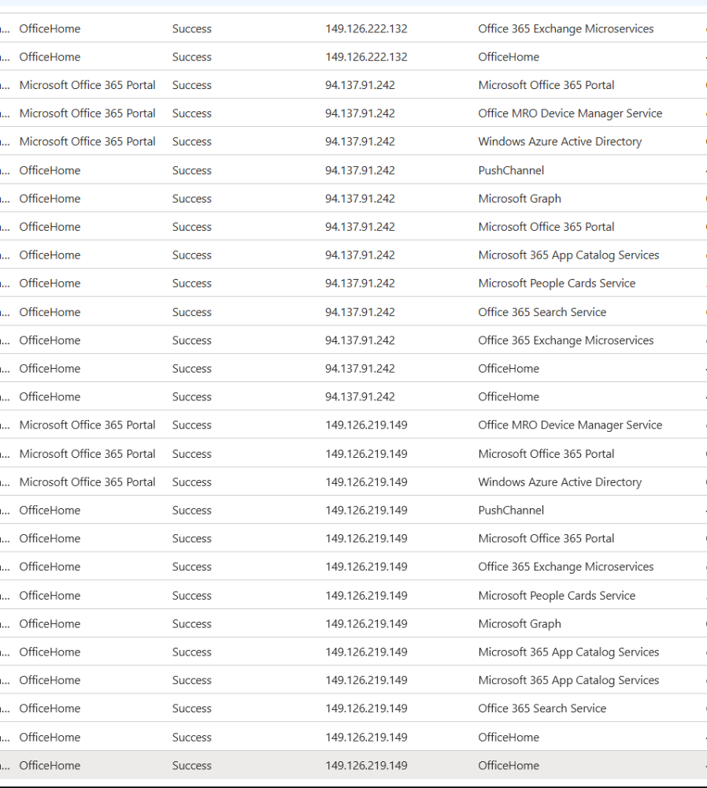
Rounding up on the attack itself
Once AiTM receives token, usually automated reconnaissance takes place*
Attackers and defenders are both against the clock! (Token will expire!)
AiTM Typically target office365 (OfficeHome) but can target anything
Can buy kits of telegram/dark web (Bring your own domain – lower skill gap)
Can host evilginx locally for testing.
Free version of evilginx may have “X-Evilginx” header, obfuscated easter egg
Evilginx pro uses more obfuscation to hide itself from scanners - not discussed here
But all things a real attacker might use
(Obfuscator.io engine, wildcard TLS certificates, DNS Zones,
Website spoofer to unauthorized users,JA4 signature spoofing, user agent denial,
Window size analysis)
Notes:
*Not going to discuss graph api logs here
By Default, Unauthorized access to evilginx results in a rick roll
https://zolder.io/aitm-attacks-using-cloudflare-workers/

Slide 9
Question Time!
If Number matching MFA can be bypassed, what can we do to stop an attacker from compromising an account?
Disclaimer: This is a prevention heavy talk
Your Risk appetite depends on you, don’t feel like you must implement everything!

Slide 10

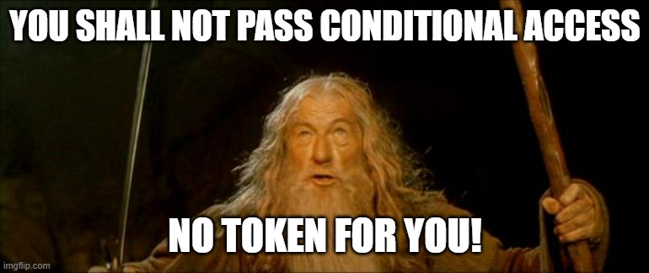
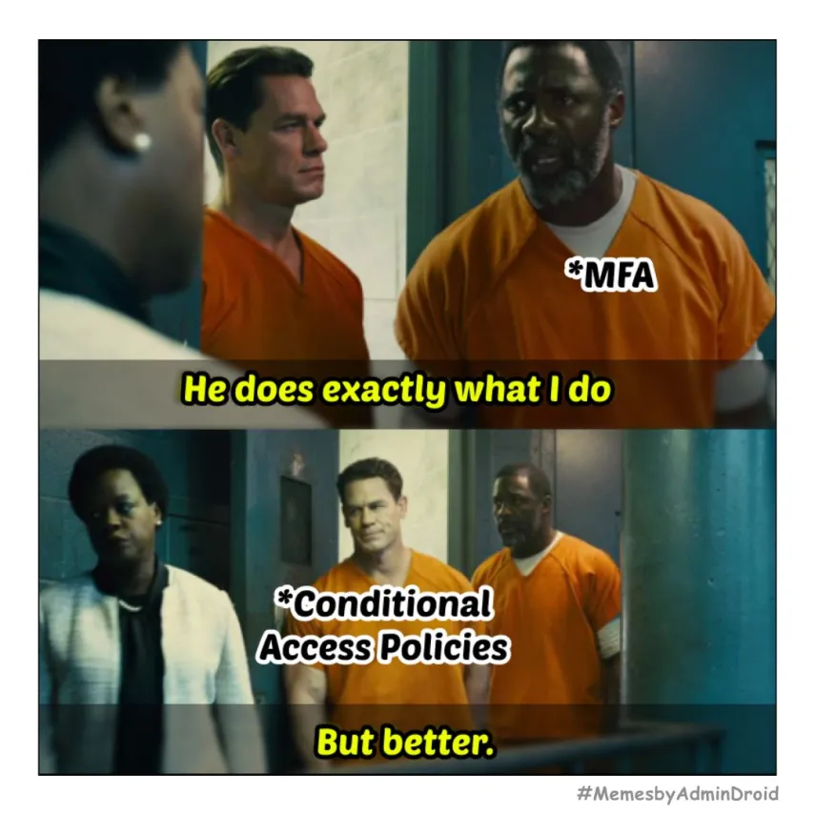

Conditional Access
It’s not always DNS….
Notes:
After token is issued CA is not evaluated again (with exceptions such as CAE,step up flow, SIF Auth context)
Conditional Access Framework (2024.6.1) - Joey Verlinden

Slide 11
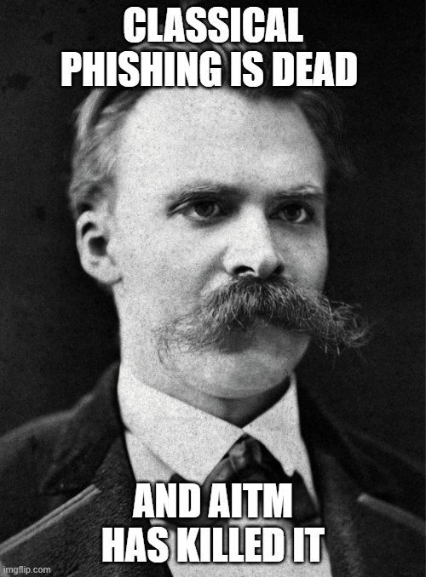
What doesn’t work against AiTMs?
The definition of insanity is seeing conditional access misconfigured over and over again

Slide 12
Conditional Access: Sign-in Risk (Identity Protection)
Usual setup is “require MFA” for medium/high risk sign-ins but attacker has bypassed this requirement! (self remediate own risk and alert gets closed down)
What can we do to increase effectiveness of risk-based sign-in?
Scope High risk to block for admin/VIP users
Apply Session Frequency to risky sign-ins to limit dwell time
If feasible append grant to require Compliant device/phishing resistant authentication etc
If you haven’t switched from the legacy risk menu now might be the time for more granular control (Deadline October 1st 2026.) – Entra P2 Requirement
Update: AiTM signal from MDE will now forward to Identity Protection so ensure you have a user risk policy also (Do not combine user risk and sign-in into one policy – it’s an “AND” not an “OR”!)
Risk based sign-in does not need to be one size fits all - Ru Campbell
Notes:
Risk policies - Microsoft Entra ID Protection | Microsoft Learn
What is Microsoft Entra ID Protection? - Microsoft Entra ID Protection | Microsoft Learn

Slide 13
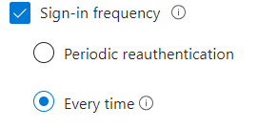
Conditional Access: Session Frequency (Controversial take?)
Can Reduce the dwell time (default rolling window of 90days) of the attacker BUT
Constant prompting trains them to be phished, encourages shorter passwords, password scripting, password.doc (honeytoken opportunity?)
AITM perfectly replicates company and Microsoft branding make it hard to spot for average user. User will give away their password!
Focus on signals to force re-prompt rather than time-based frequency (CAE - location, risk, SOAR,Protected Action etc.)
Prevent attacker from getting token to begin with!
Only use SIF when it makes sense to e.g. BYOD Devices not enrolled in Intune (if you allow this, otherwise block!)
For Privileged applications you may want to scope SIF of every time to those particular apps (consider double edged sword of SSO – won’t discuss SSO abuse or ID tokens here)
Ref: https://www.linkedin.com/pulse/constant-password-prompting-does-equal-more-secure-entra-jay-kerai-84q6e
Note: Access Token lifetime is not affected by SIF
SIF
Eval
Notes:
Sign-in frequency (SIF) works with third-party SAML applications and apps that implement OAuth2 or OIDC protocols, as long as they don't drop their own cookies and are redirected back to Microsoft Entra ID for authentication on regular basis.

Slide 14
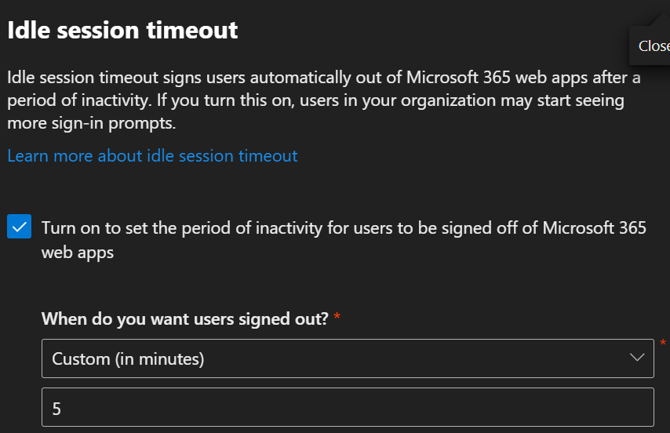
On the same note…Idle Session Time Out
Not a real security control against AiTM
Trivially bypassed (mouse clicks / keyboard presses), clicking “keep me signed in”
Never Persistent browser session does not work either against AITM (will cover at end if time )
Notes:
Users won’t get signed out in these cases.
If they get single sign-on (SSO) into the web app from the device joined account.
If they selected Stay signed in at the time of sign-in. For more info on hiding this option for your organization, see Add branding to your organization's sign-in page.
If they're on a managed device (one that is compliant or joined to a domain) and using a supported browser like Microsoft Edge or Google Chrome (with the Microsoft Single Sign On) extension.
https://learn.microsoft.com/en-us/microsoft-365/admin/manage/idle-session-timeout-web-apps?view=o365-worldwide#details-about-idle-session-timeout

Slide 15
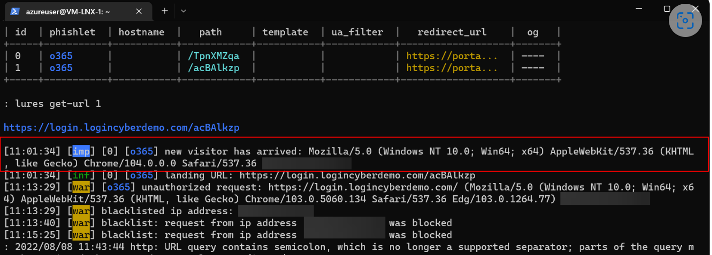
Conditional Access: Block Certain Device Platforms/User agents
Good idea but easily defeated, attacker can see what user agent is visiting site & spoof accordingly. (have seen this a lot)
While it can be defeated it is still worth detecting a change in user agent/change in country
Notes:
While it can be defeated it is still worth detecting a change in user agent/change in country/downgrade of user agent browser version
| extend UserAgentDetail = todynamic(parse_user_agent(UserAgent, "browser"))
Advanced Hunting Query:
let OfficeHomeSessionIds =
AADSignInEventsBeta
| where Timestamp > ago(1d)
| where ErrorCode == 0
| where ApplicationId == "4765445b-32c6-49b0-83e6-1d93765276ca" //OfficeHome application
| where ClientAppUsed == "Browser"
| where LogonType has "interactiveUser"
| summarize arg_min(Timestamp, Country) by SessionId;
AADSignInEventsBeta
| where Timestamp > ago(1d)
| where ApplicationId != "4765445b-32c6-49b0-83e6-1d93765276ca"
| where ClientAppUsed == "Browser"
| project OtherTimestamp = Timestamp, Application, ApplicationId, AccountObjectId, AccountDisplayName, OtherCountry = Country, SessionId
| join OfficeHomeSessionIds on SessionId
| where OtherTimestamp > Timestamp and OtherCountry != Country
union SigninLogs , AADNonInteractiveUserSignInLogs
| where isnotempty(UserAgent) //| extend UserAgent = replace_string(UserAgent,";","") | where ResultType == "0" | extend UserAgentDetail = todynamic(parse_user_agent(UserAgent, dynamic(["browser","os","device"]))) | extend OS = strcat(parse_json(tostring(UserAgentDetail.OperatingSystem)).Family," ",parse_json(tostring(UserAgentDetail.OperatingSystem)).MajorVersion,parse_json(tostring(UserAgentDetail. OperatingSystem)).MinorVersion) | extend UserAgentDetail = todynamic(parse_user_agent(UserAgent, "browser")) | extend UserAgentFamily = tostring(parse_json(tostring(UserAgentDetail.Browser)).Family) | extend UserAgentMajorVersion = toint(parse_json(tostring(UserAgentDetail.Browser)).MajorVersion) | extend UserAgentMinorVersion = toint(parse_json(tostring(UserAgentDetail.Browser)).MinorVersion) | where isnotempty(UserAgentMajorVersion) | extend UserAgentMinorVersion == iff(isempty(UserAgentMinorVersion),0,UserAgentMinorVersion) | summarize Count=count() by UserAgentFamily, UserAgentMajorVersion, UserAgentMinorVersion, OS | sort by Count

Slide 16
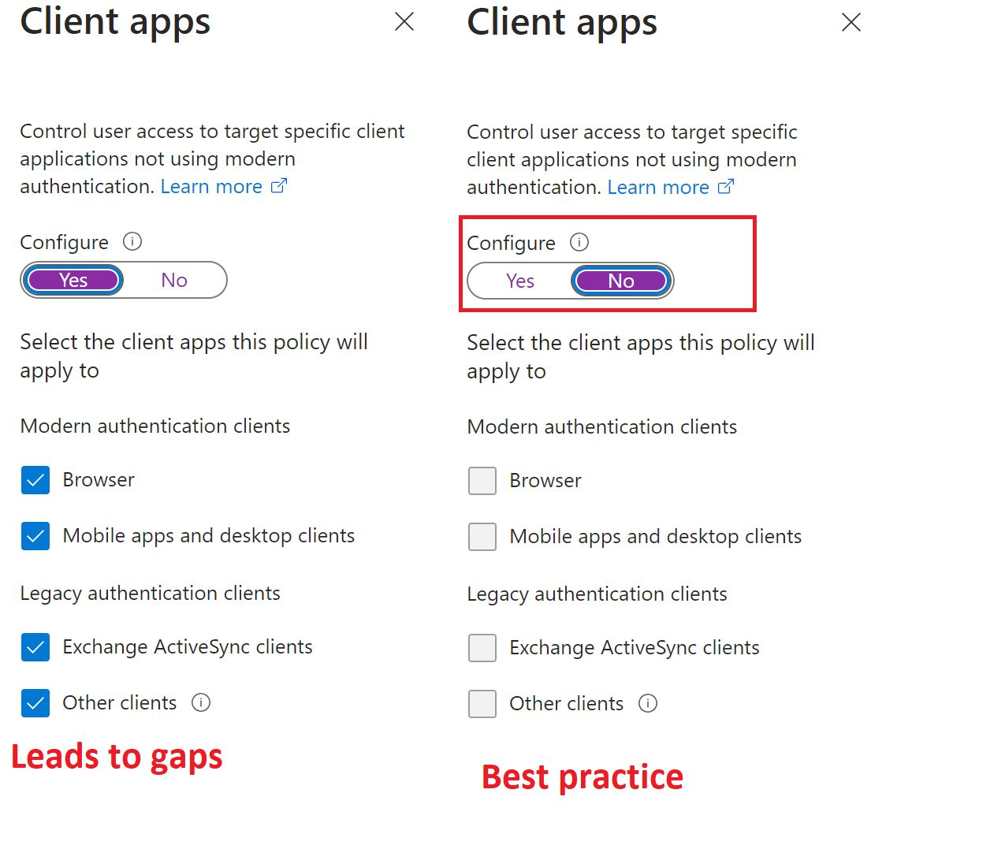
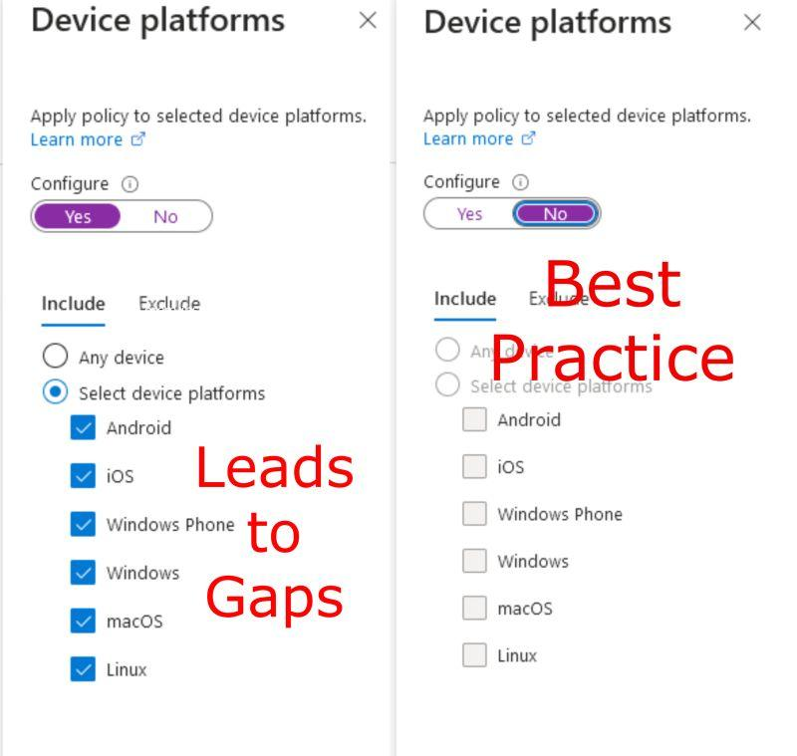
User agent continued
Conditional access mistake – spoofing user agent is trivial e.g. hit F12 in browser to open Device Emulation, “Request Desktop Site” on mobile
Use Any Device + Exclude vs. Include for intended Devices when blocking UAs. Highly unusual user agents get throttled/blocked at azure WAF level anyway.
Jay’s Nitpick: Do not click “any device” unless you plan to set exclusions
Notes:
Request desktop site – fun one to walk past MAM for a mobile phone
Spoof user agent in edge using Device emulations (f12 to open dev tools)
Use Any Device + exclude vs Include Devices

Slide 17
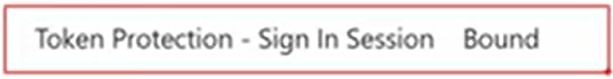
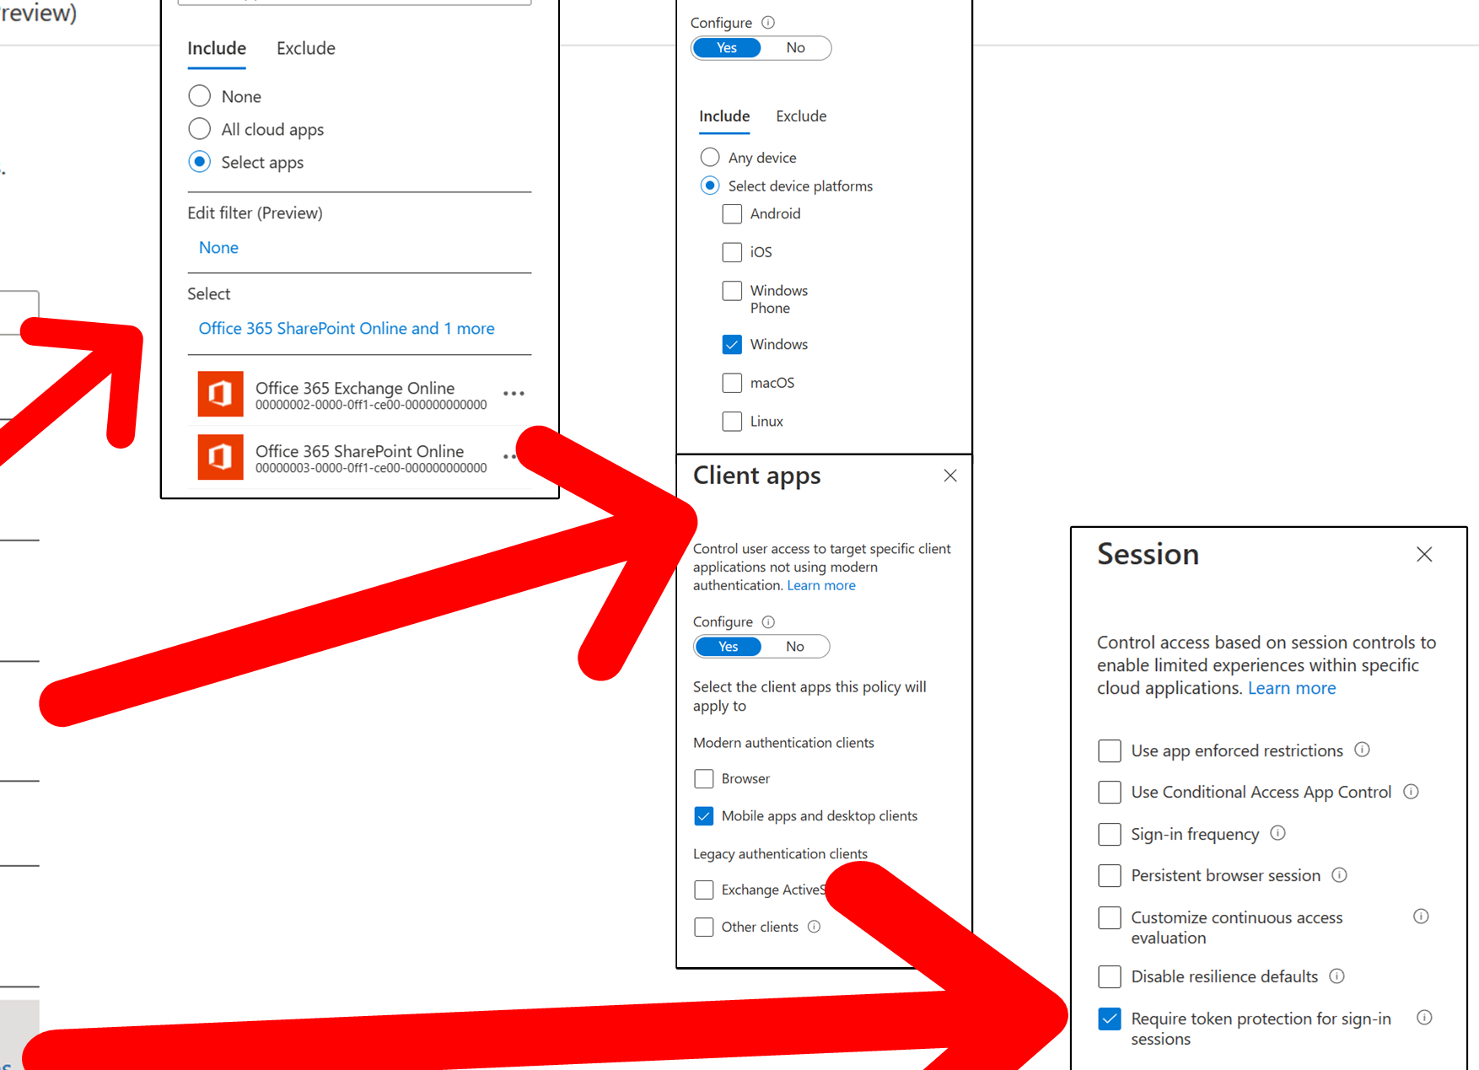
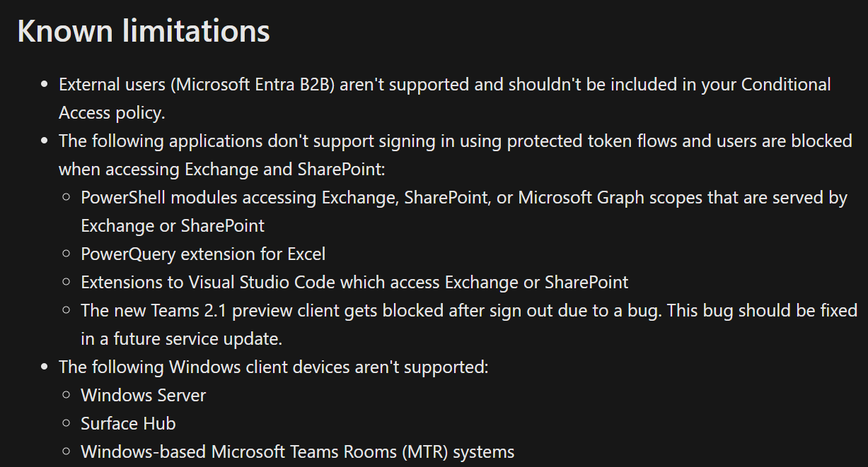
Conditional Access: Token Protection
Policy enforces token must be bound to Device using TPM
Leans toward classical token theft (i.e. token only usable on client it was issued to, but token issued to AiTM!)* (more complex than this, will circle back)
Microsoft Recommendation is to NOT scope Browser to policy! -> AiTM can walk past
Easy to lock users out, better option coming up that is based on one of the same requirements
Edge only natively supported browser?
Support is really limited but should improve
I’ve seen Linux/MacOS AiTMs too
Notes:
preview supports the following configurations for access to resources with Token Protection Conditional Access policies applied:
Windows 10 or newer devices that are Microsoft Entra joined, Microsoft Entra hybrid joined, or Microsoft Entra registered.
OneDrive sync client version 22.217 or later
Teams native client version 1.6.00.1331 or later
Power BI desktop version 2.117.841.0 (May 2023) or later
Visual Studio 2022 or later when using the 'Windows authentication broker' Sign-in option
Office Perpetual clients aren't supported
In theory if you scoped to All Cloud apps and all device platforms then yes token protection would work as it comes with the fact the device is joined to entra
Microsoft Entra WAM plugin: When users try to access applications, the Microsoft Entra WAM plugin uses the PRT to enable SSO on Windows 10 or newer. Microsoft Entra WAM plugin uses the PRT to request refresh and access tokens for applications that rely on WAM for token requests. It also enables SSO on browsers by injecting the PRT into browser requests. Browser SSO in Windows 10 or newer is supported on Microsoft Edge (natively), Chrome (via the Windows 10 Accounts or Mozilla Firefox v91+ (Firefox Windows SSO setting)

Slide 18
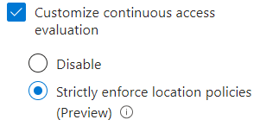
Conditional Access: Continuous Access Elevation (CAE)
Sadly doesn’t automatically kick attacker out after obtaining token (or rather cannot be relied on)
CAE for risk/account disabled (i.e. event driven) is enabled by default but can be turned off
CAE CAN help for post remediation (marking user as compromised, account disable) assuming supported CAE app (what if attacker uses an application that does not support the CAE claim?)
CAE for locations can help for classical token theft attacks (CAE for locations is NOT enabled by default)
Access Tokens are not evaluated by Entra after being issued, this is why you cannot revoke an access token. Attacker will get ~60 mins access @ resource scope even if you respond instantly to a successful Aitm. CAE is aimed at solving this by using network location & Critical Event.
Access Tokens are NOT evaluated by conditional access after being issued
Access Tokens will have NO knowledge of a password reset etc. without CAE
Attacker could use gained refresh token to instantly gain access tokens for other resource scopes!!!
Notes:
CAE not supported at ARM/azure management level
https://openid.net/specs/openid-sse-framework-1_0-01.html
https://cloudbrothers.info/en/continuous-access-evaluation/

Slide 19
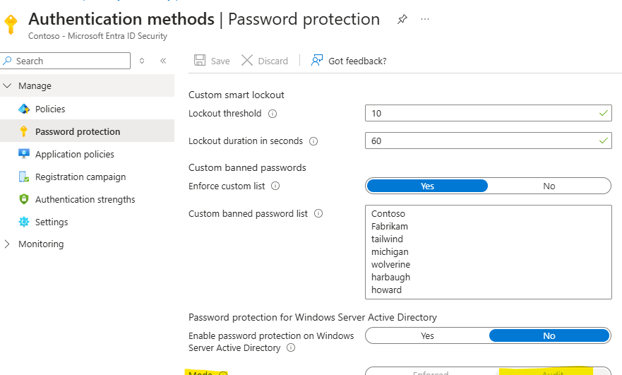
Banned Passwords/Password Protection
Good idea, however irrelevant as attacker is “gifted” the password in plain text
But consider scraping password breaches for your domain(s) and blocking normalized version of passwords (exposed.lol (free), leekpeek, intelx.io, recorded future,Hudson rock,leakcheck)
Banned Password is not retroactive. Only applied at password change (hashing! Entra only has PBKDF2 representation of password).
Microsoft’s banned password algorithm is quite lenient on variants of banned passwords (score of 5*)
Microsoft recommendation for banned passwords:
Brand names
Product names
Locations, such as company headquarters
Company-specific internal terms
Company Abbreviations (must be > 4 characters)
*Password calculation is difficult in Entra, so I wrote a tool to assist admins: https://github.com/jkerai1/AzurePasswordProtectionCalculator
I also wrote: https://github.com/jkerai1/GeneratePasswordListFromWebsite
Need OnPrem Agent To enforce back on-prem, this is NOT part of MDI
Notes:
Make sure you have the agent for on-premise enforcement
Free API:
https://cavalier.hudsonrock.com/api/json/v2/osint-tools/search-by-email?email=neroangelo636@gmail.com

Slide 20
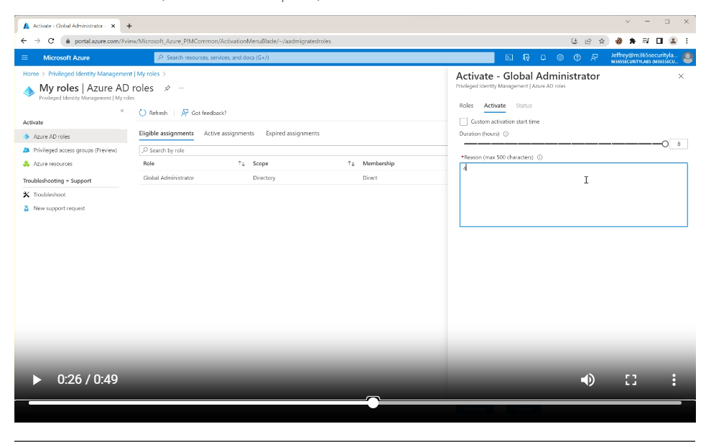
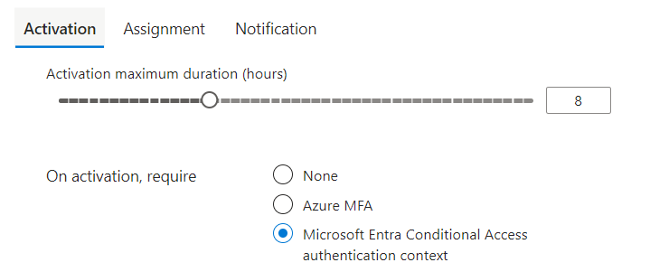
PIM: Self Approval with MFA
PIM trusts MFA in the token, use authentication context for phishing resistant/compliant device instead of Azure MFA! (Classical Token Theft Defeats this too)
Attacker will then be forced to “step-up” authentication as number matching claim will be “too weak”.
If phishing resistant not feasible you could use Auth Context with Session Frequency of every time however bear in mind there is a grace period for re-prompts and attacker may be in grace period! (SIF evaluation is complex….) – weigh pros and cons of this yourself.
Can Apply Auth Contexts to Protected actions too for another guard rail (e.g. Cross Tenant access/Updating Named Locations/Updating CA)
Ref: https://campbell.scot/pim-common-microsoft-365-security-mistakes-series/
Ref: https://jeffreyappel.nl/protect-against-aitm-mfa-phishing-attacks-using-microsoft-technology/
You can only configure 1 auth context per PIM so ideally only configure grant (and users)!
SIF
Eval

Slide 21
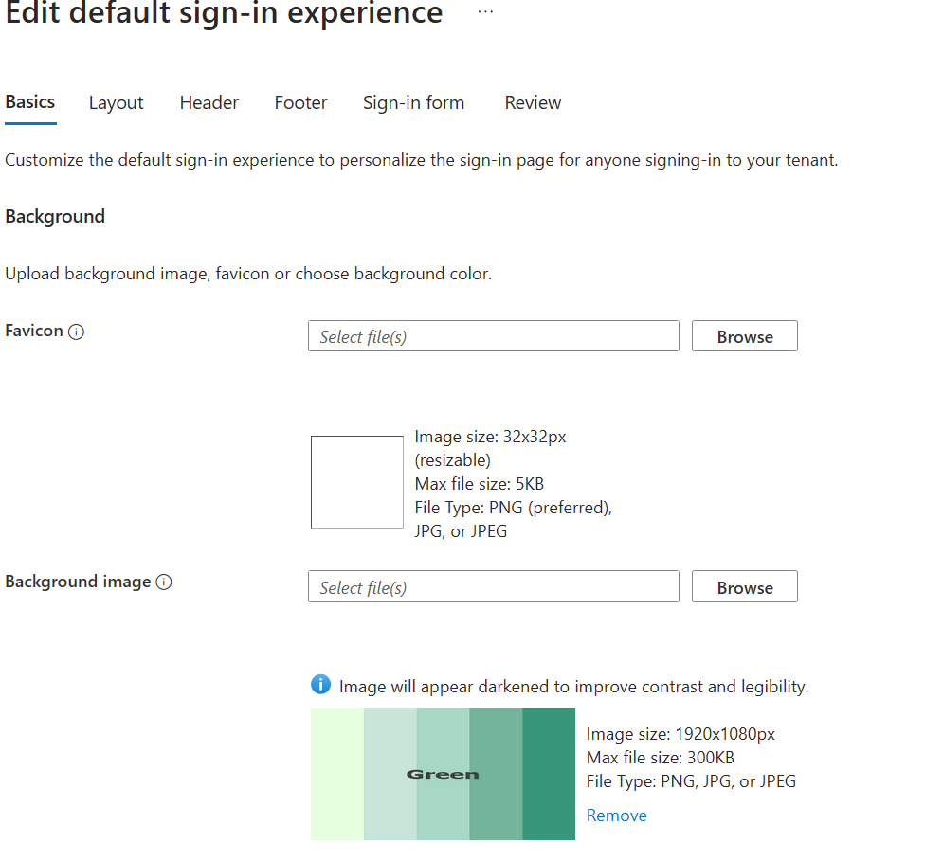
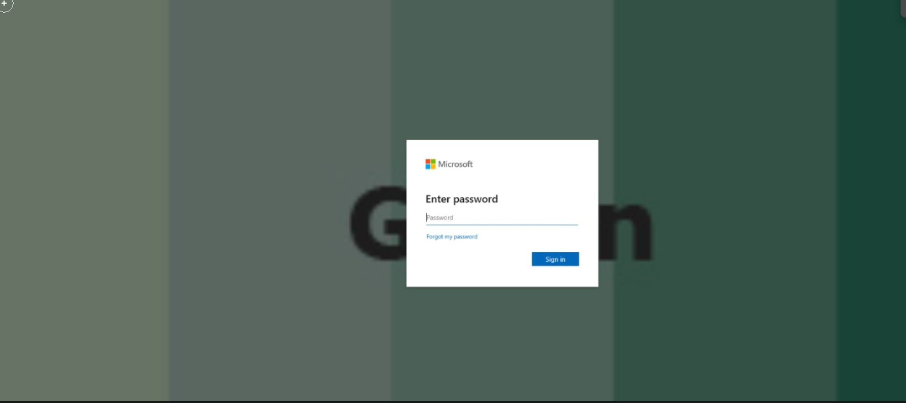
Company Branding/Home Realm Discovery
Company branding is being perfectly mimicked as being pulled straight from Microsoft service so this is not a good indicator user should not put password in
Pulled my branding from honeypot tenant, I know this is AiTM and not a classical phish!
Notes:
A dead giveaway you are dealing with an AiTM rather than generic phish before even entering password is the Sign-in experience so I pulled an image of the internet to use as my default sign-in. As I'm using a fresh tenant there is a very slim chance an attacker has this cached for my particular tenant. This also implies AiTM rather than targeted attack against my tenant.

Slide 22

AiTMs can break!
Broken phishlet for MFA prompt? (phishlet is instruction for evilginx on how to handle the page)
More importantly this shows….

Slide 23
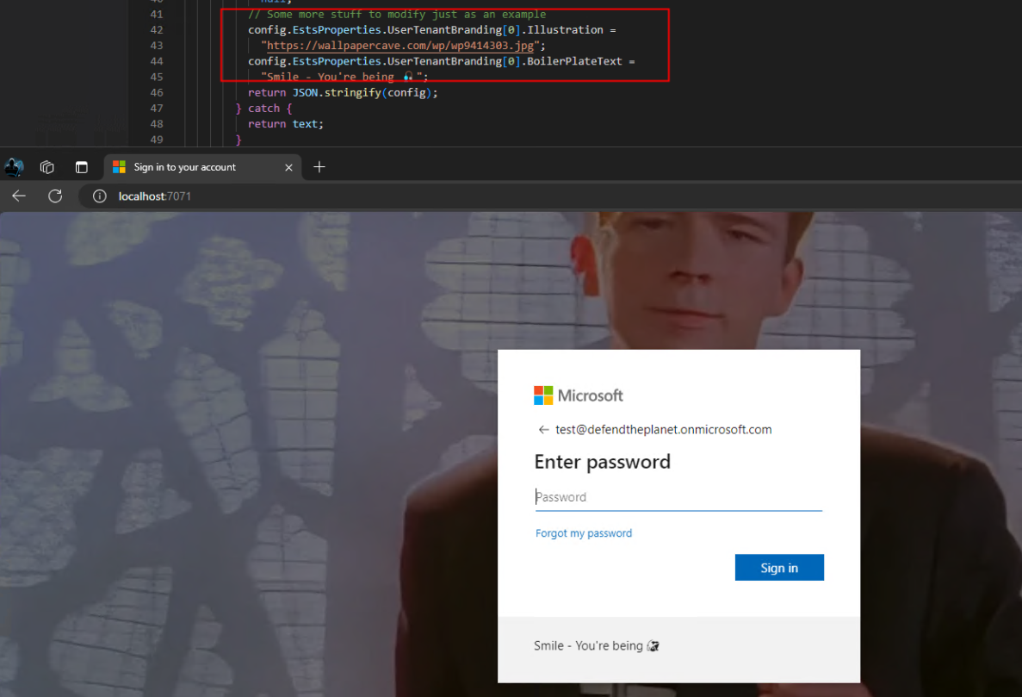
Attacker Controls the Proxy!
Can serve back any image/text they want (yes even Rick Astley!)
Can Inject Javascript also -> useful for prefilling email address to make more convincing
Leads into next control that doesn’t necessarily work….
This is not Evilginx but uses the same concept https://github.com/nicolonsky/AzureAiTMFunction - Shoutout Nicola Suter
Notes:
Not just limited to pictures attacker can inject javascript too -> useful for prefilling email address to make phishing page more convincing (using encoded url param)
Javascript injection also useful for ticking boxes “keep me signed in” etc.

Slide 24
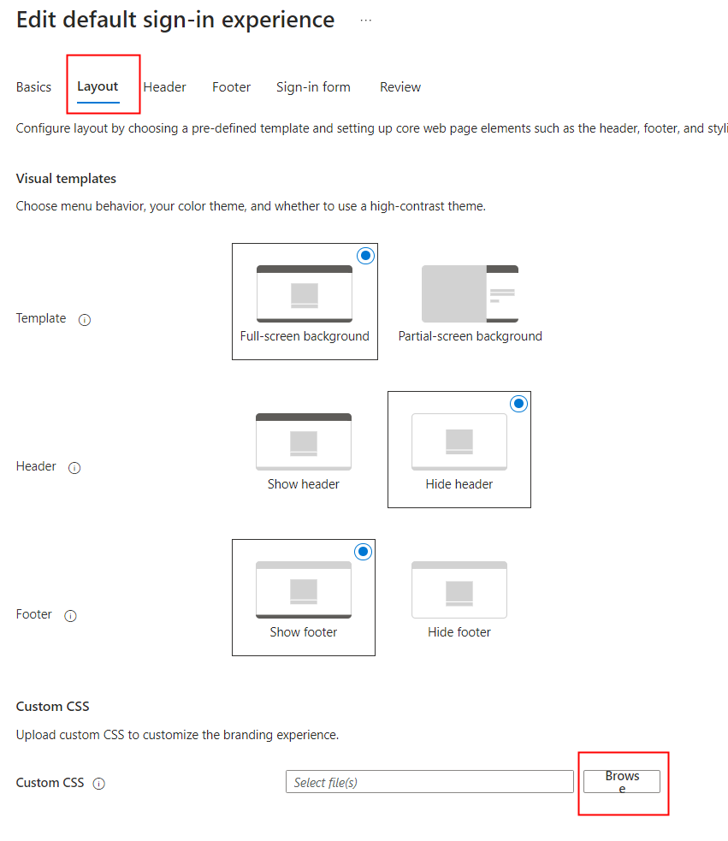
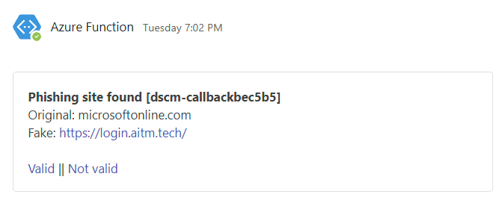
Canary Tokens – Get the attacker to announce themselves
Idea is to Inject Canary token as CSS into sign-in page, if page referrer is not a Microsoft referrer the login page is being cloned/served via AiTM
Typically used to push notifications to Security Team e.g. https://didsomeoneclone.me/
Ref: https://www.linkedin.com/pulse/punishing-aitms-using-css-flask-jay-kerai-ffrhe/
This is great but doesn’t stop users giving away their password!

Slide 25
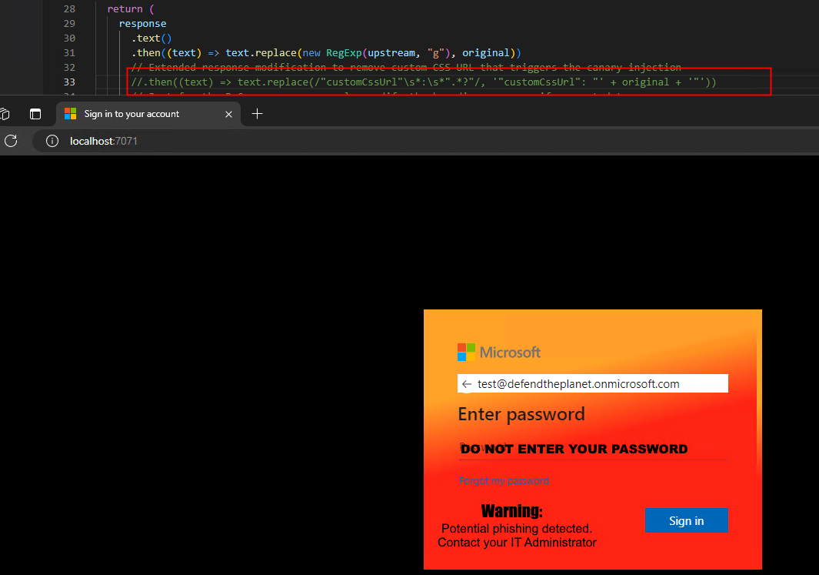
Canary Tokens Part 2
We can create a warning system but remember attacker is in control of the proxy so they can strip out the CSS
Need to flip the logic for this to work (I Wrote a tool using flask from a clarion fork: https://github.com/jkerai1/clarion)
Shout
Ref: https://www.linkedin.com/pulse/punishing-aitms-using-css-flask-jay-kerai-ffrhe/
Non-Microsoft referrer (localhost) + no CSS Striping = Definitely phishy
Shoutout CIPP (Kelvin Tegelaar) for the Sign-in box image
Notes:
Never come across an aitm that doesn’t strip CSS

Slide 26
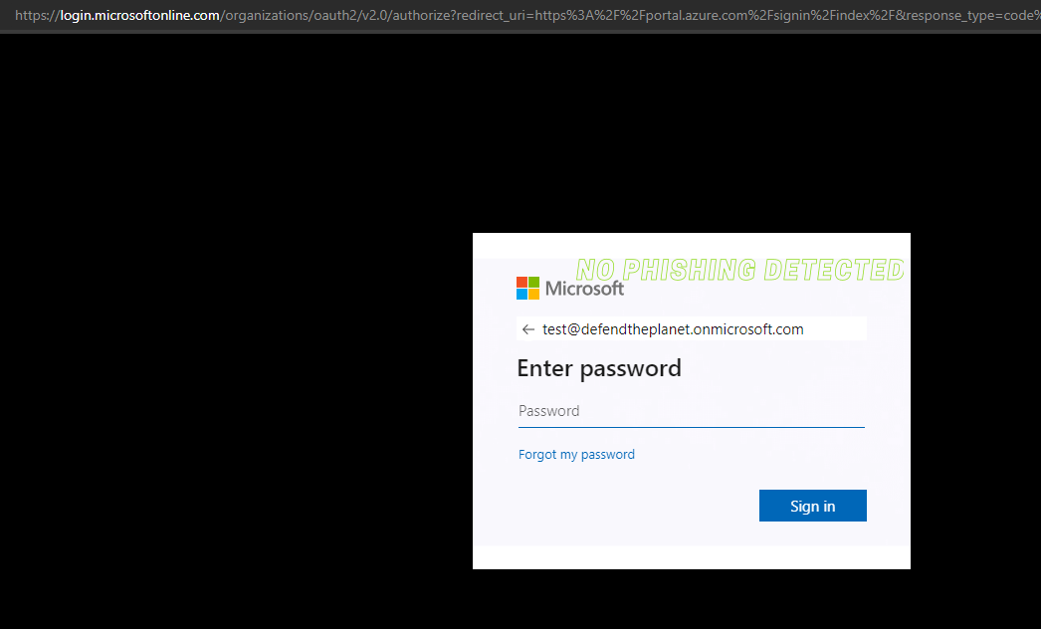
Canary Tokens Part 3
Legitimate Sign-in: URL in CSS is routed through (i.e. no CSS Stripping has taken place), safety message “no phishing detected” sent back to user
My Graphic skills suck.. I know…

Slide 27
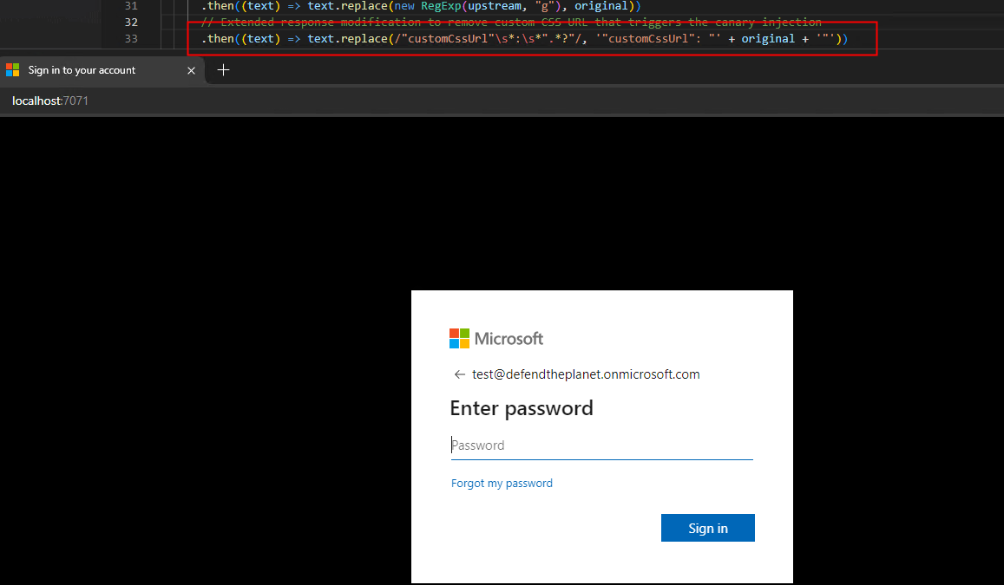
Canary Tokens Part 4
No safety message when routed via AiTM as CSS is striped – user should be instructed prior to not put creds in when they don’t see the green text.(user can ignore instruction of course…)

Slide 28
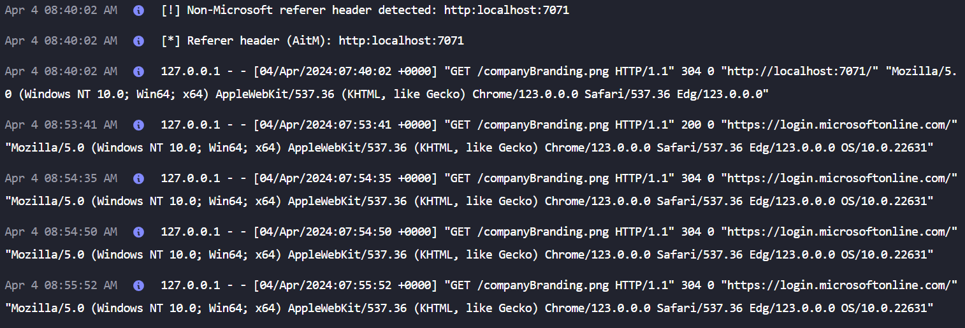
Canary Token Part 5
The modified CSS Method is NOT perfect it can be defeated by prefetching the image or a “Browser in the middle” using the webstream technique (i.e. victim is interacting with a screenshare of the attackers desktop – though never seen this in the wild)
Flask application itself gives us logs, can be used to detect AiTM – absence of sign-in going through the flask application could be sign of AiTM as ALL AiTMs are using CSS Striping
Notes:
Disabling WebRTC could limit Webstream technique though could have business impact as browser conferencing software would cease to work

Slide 29
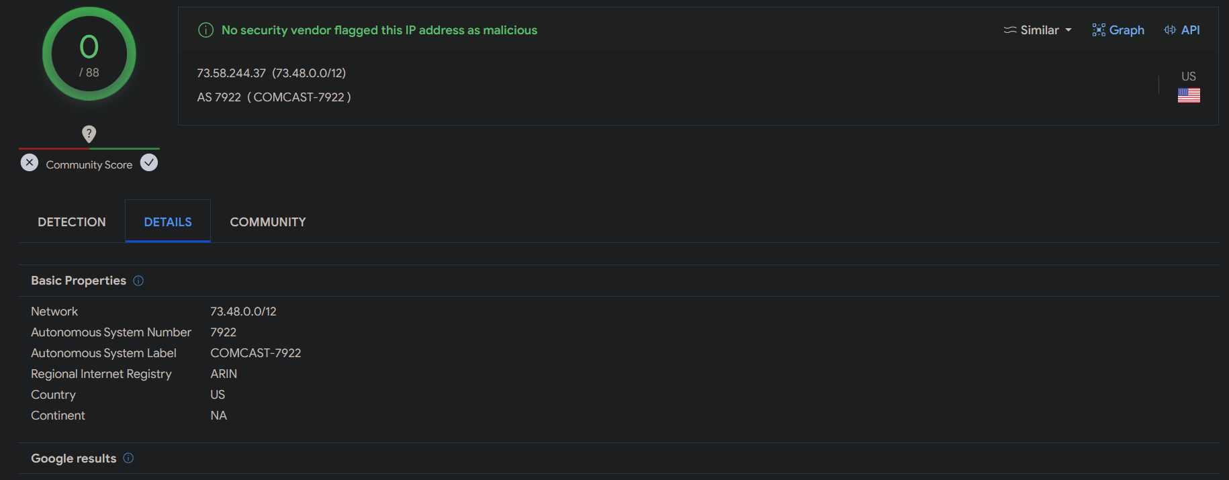
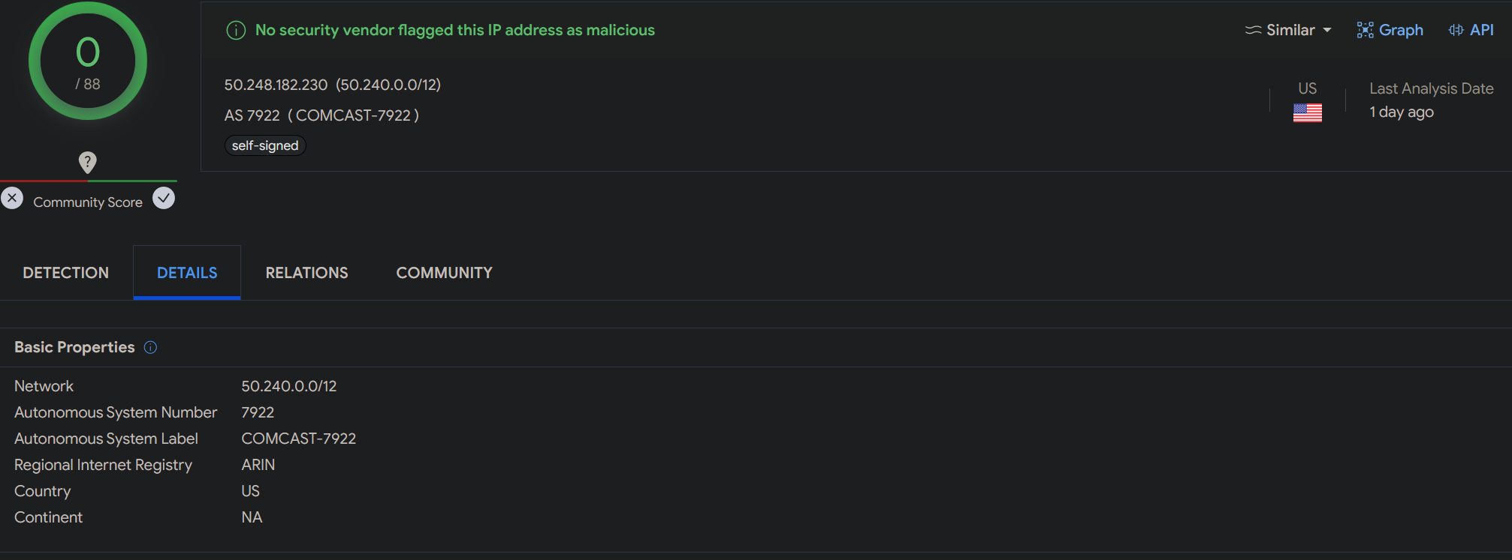
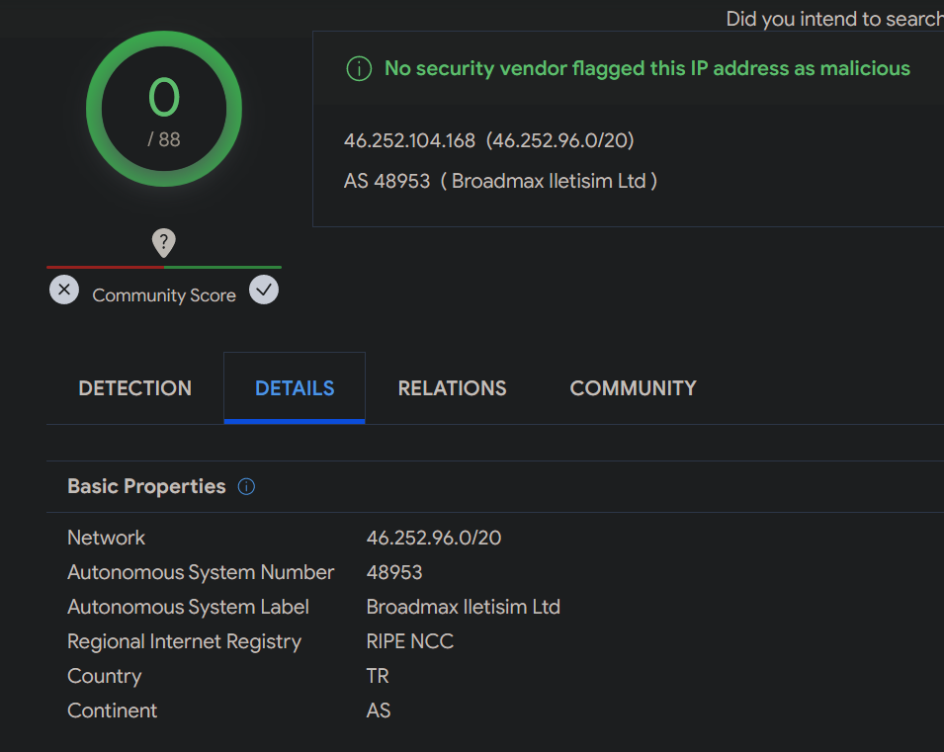
IP reputation / Reverse DNS
Attackers can bypass IP reputation checks by using residential proxies (Proxy the proxy)
Phishing page rarely hosted on same IP as attacker is using to sign-in from, so reverse DNS check fails (e.g. hosted on cloudflare, more on that later..)
Attackers can also bypass geolocation blocks because they can see the incoming IP to their page and proxy off accordingly
I have noted SSH (Port 22) is often open on these residential proxies (SOAR Opportunity*!)

Slide 30
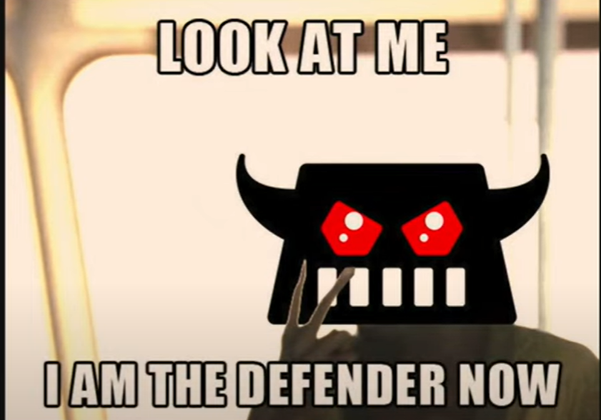
What does work against AiTMs?
Promise I’ll stop talking about conditional access soon

Slide 31
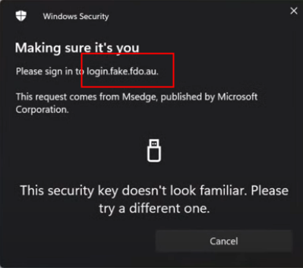
What about FIDO/WebAuthN?
No Credential bound to AiTM URL, essentially nothing happens*
User needs to be aware if they see that the key isn’t familiar, they shouldn’t fall back to Password (be a good admin and use Temporary Access Pass if you’re doing true passwordless).
Even if you do passwordless with TAP, user may still give away a password as a “guess”. User gonna user…
AiTM may not respect the primary auth method (Javascript injection/poor phishlet) on the account and user maybe prompted for a non-FIDO method FIRST. After FIDO Rollout remove Passwordless Authenticator Auth Method/Exclude from Auth Strengths.
If attacker spoofs user agent on the proxy itself to one that does not support FIDO, user may fall back to password + number matching MFA if that is available to them. (os/2 warp?)
Use Authentication strengths! AiTM will not get a token containing a FIDO Claim
Don’t forget to disable User Risk password reset for true-FIDO users
FIDO does not stop classical token theft**
Token Binding optional in FIDO spec (RFC 8471)
Microsoft address token binding problem with token protection instead
FIDO has some other problems but not discussed here Ref: https://www.linkedin.com/pulse/passwordlessphishing-resistant-considerations-entra-jay-kerai-zh6nc
Notes:
https://www.w3.org/TR/webauthn/#dictdef-tokenbinding
Security Analysis and Bypass User Authentication Bound to Device of Windows Hello in the Wild (wiley.com)

Slide 32
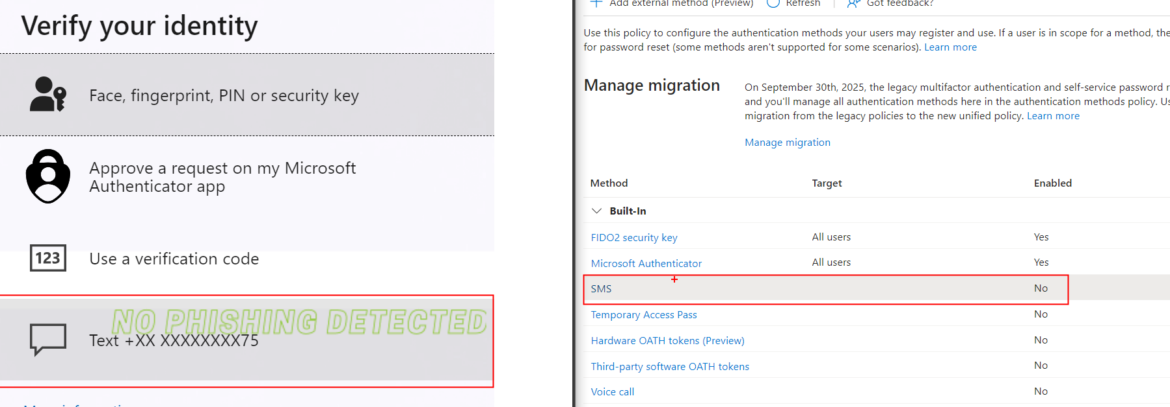
FIDO SSPR quirk?…..
Reminder: Authentication Strengths
SMS allowed as MFA method despite auth methods option set to no! SMS was enrolled as part of SSPR flow
If you remove SMS method from admin, you’ll end up in prompt loop to enrol SMS unless you disable SSPR for Admins using PowerShell
Notes:
Microsoft have tried for a while to remove SMS method and migrate users to auth app, as mentioned before this is better as MFA prompts can be suppressed

Slide 33
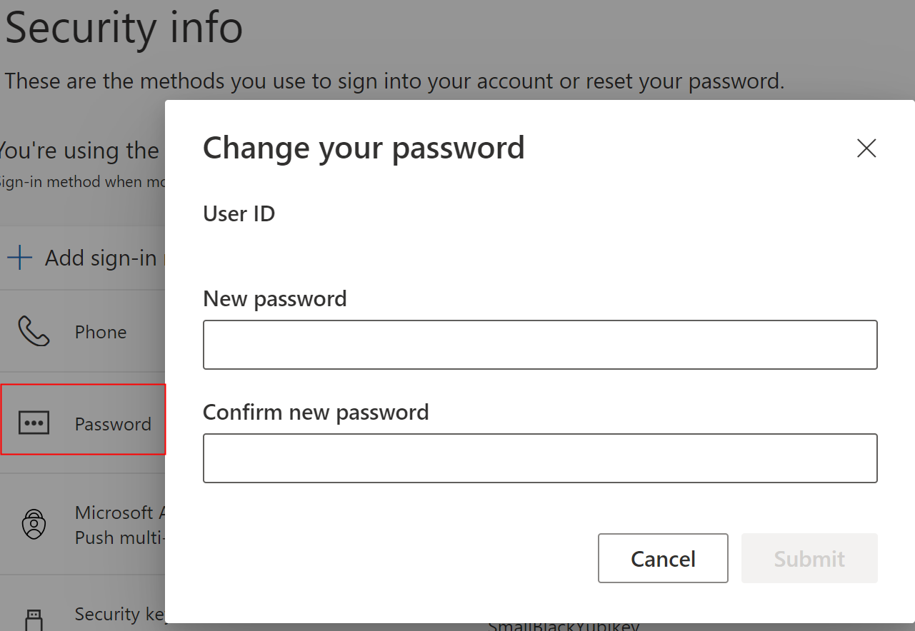
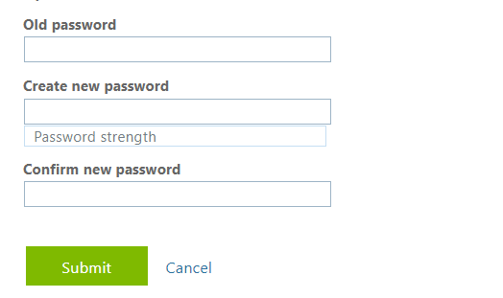
Change Password without Old Password Quirk
FIDO cannot be used for direct SSPR but you can (but not always?) reset password with FIDO without knowledge of old password if you use Security Info page!
Legacy Menu required old password
There are more FIDO Quirks, not discussed here: https://www.linkedin.com/pulse/passwordlessphishing-resistant-considerations-entra-jay-kerai-zh6nc
Reminder: Authentication Strengths
Notes:
Unsure of what causes this behaviour

Slide 34
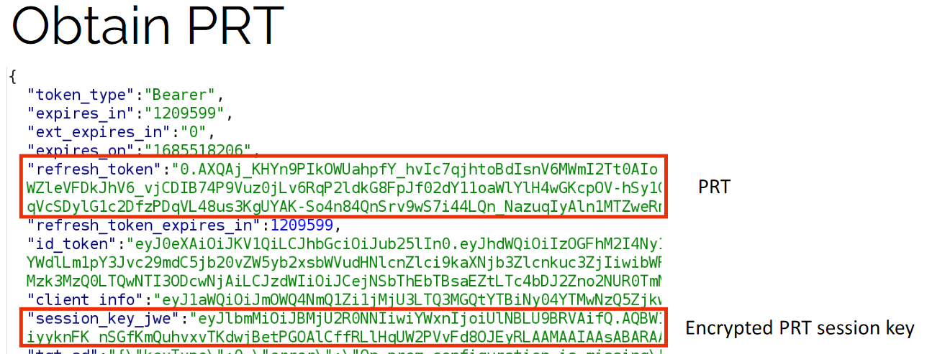
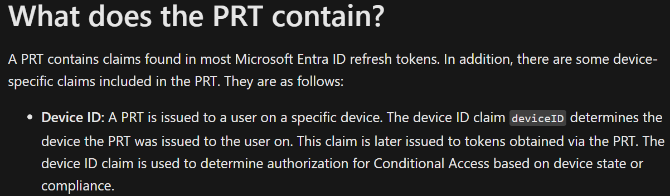
Conditional Access: Require Joined/Compliant device/ Block non-compliant filter (1)
Most effective known control for stopping AiTMs!
The 3 options work slightly differently, block Excluding compliant filter is most restrictive as user can be prompted to become compliant if using Grant
Attacker’s proxy/device is not enrolled into Entra, no Primary refresh token (PRT) available, thus fails conditional access
No Entra join/register -> No PRT -> No Device ID Claim-> No Key in TPM -> No “Token Protection” as relies on same key! (coming full circle!)
Stealing/Abusing PRT is very difficult without causing alerts, being prevented or physical access to the device (if I already have a PRT & Session key I don’t really need AiTM)
Notes:
When you enroll your device into entra, 2 keys are bound to the TPM. (device/transport)
When your device issues a PRT request to Entra it is signed with the device key, Entra validates this with the public key it got at registration time. If the key pairs match then the device sending request is same one from registration time. The PRT is then issued and the Device ID claim is added to consequent tokens.
Entra also issues the session key which is encrypted with the transport key and serves as proof of possession as its required for signing token requests or PRT Renewal. The session key is TPM bound also. Somewhat simplified explanation, in reality there are more steps.
-----------
Token Protection -> basically enforces that the incoming token type must be a PRT, by default entra uses PRT first if it can. This is free protection from classical token theft just by joining or registering to entra because even if the token is stolen its useless without the session key. Entra invalidates any requests from the device that aren't signed by the corresponding session key.
Session key rolls every 30 days
This session key can only be decrypted by the private transport key (tkpriv) secured by the TPM. The session key is the Proof-of-Possession (POP) key for any requests sent to Microsoft Entra ID.
Private keys are bound to the device's TPM if the device has a valid and functioning TPM, while the public keys are sent to Microsoft Entra ID during the device registration process. These keys are used to validate the device state during PRT requests.
Intune refresh average 8 hours
Primary Refresh Token (PRT) and Microsoft Entra ID - Microsoft Entra ID | Microsoft Learn
TPM Attest: https://youtu.be/j0D3So1q-IA?t=554
Using filter for devices won’t prompt user to enroll vs the grant option

Slide 35
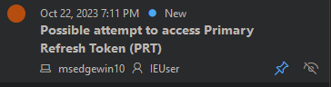
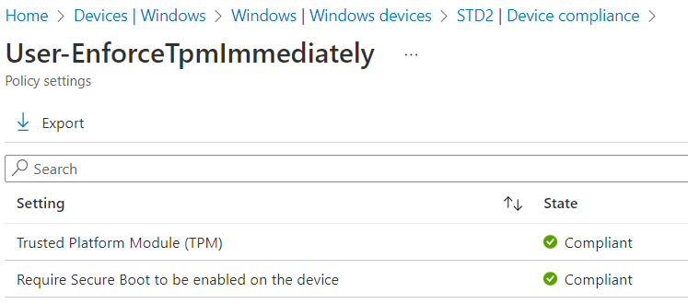
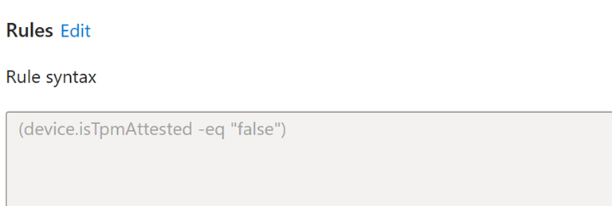
Conditional Access: Require Joined/Compliant device/ Block non-compliant filter (2)
Consider adding device risk to compliance policy to block access for any user accessing from an infected device
Device with no TPM -> trivial to steal PRT: TPM Attest enrolment restriction & TPM/Secure Boot in Compliance Policy. Block all devices that didn’t perform a successful attestation
Alert needs to be closed before I’m allowed access again.
MDE can forward PRT detection to Identity Protection also!
Notes:
block all devices that didn’t perform a successful attestation
TPM Attest: https://youtu.be/j0D3So1q-IA?t=554
IsTPMAttested | 80180032 | Windows Enrollment Attestation (call4cloud.nl)
TPM issues: Sometimes, a device's TPM can falter or fail, leading to inaccessibility of keys secured by the TPM. In this case, the device is incapable of getting a PRT or requesting tokens using an existing PRT as it can't prove possession of the cryptographic keys. As a result, any existing PRT is invalidated by Microsoft Entra ID. When Windows 10 detects a failure, it initiates a recovery flow to reregister the device with new cryptographic keys. With Microsoft Entra hybrid join, just like the initial registration, the recovery happens silently without user input. For Microsoft Entra joined or Microsoft Entra registered devices, the recovery needs to be performed by a user who has administrator privileges on the device. In this scenario, the recovery flow is initiated by a Windows prompt that guides the user to successfully recover the device.

Slide 36
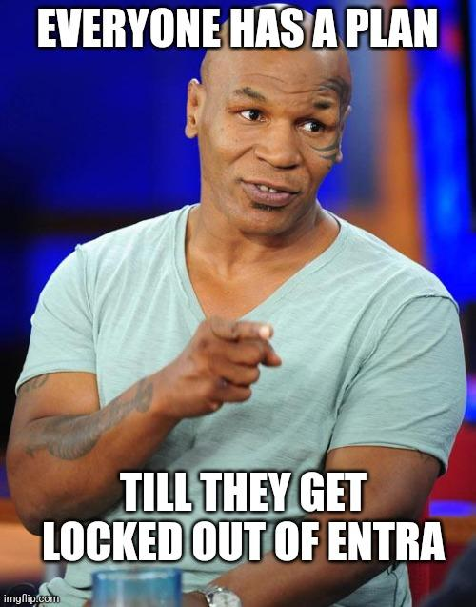
Conditional Access: Named Locations
Block Unless coming from Compliant Network (if doing Global Secure Access) or Company IP range
Countries as named locations are alright but reliant on IANA blocks (refreshes every 30 days in azure) – in practice rarely an issue
Attacker knows what country victim is coming from & could forward accordingly
Access Tokens seem to be bound to the datacentre geography they are issued to (can’t use a EMEA token in APAC region)
Combine with CAE for “auto” revoke! (Strict enforcement CAE for countries seems to be depreciated)
Reminder: Start CA changes in report-only/Pilot groups. No support for report only with CAE
Ref: https://cloudbrothers.info/en/continuous-access-evaluation/
Notes:
access token from one Microsoft 365 datacenter geography region is only valid within the geography it was issued.
Global Geography 1 – EMEA (Europe, Middle East and Africa)
Global Geography 2 – Asia Pacific Global Geography
3 - Americas

Slide 37
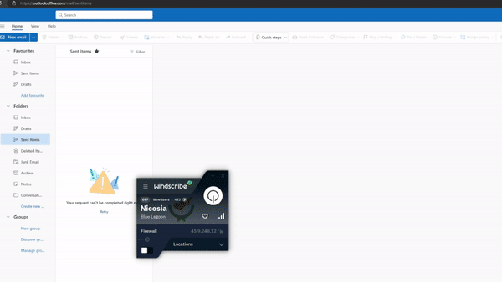
Demo: Continuous Access Elevation with named locations
CAE with locations is still effective for classical token theft.
Not all cloud applications support CAE unfortunately (like Azure portal!)
Entra uses IP address making request not IP in token (why you may see 2 IP addresses in CAE token log) – More Significant than it sounds!
FYI: No 28-hour lifetime when exceeding 5000 IP limit e.g. Country
CA Setup: Block Access
Exclude Trusted Location
Strictly Enforce CAE
Notes:
It gets around claims being imprinted in the token whether it’s the MFA claim or device ID claim, if I steal an access or refresh token from a compliant device and replay it from another device it will show as the original device and as compliant despite the fact that device has nothing to do with intune or entra
Token isn’t actually invalidated its just not useable from other IPs
https://cloudbrothers.info/en/continuous-access-evaluation/#how-i-think-its-implemented
The access token wasn’t invalidated completely and from the work computer, the user was was still able to use this access token. CAE just enforces it must be used by the Allowed IP address
When the sum of all IP ranges specified in location policies exceeds 5,000, CAE can't enforce user change location flow in real time. In this case, Microsoft Entra issues a one-hour CAE token

Slide 38
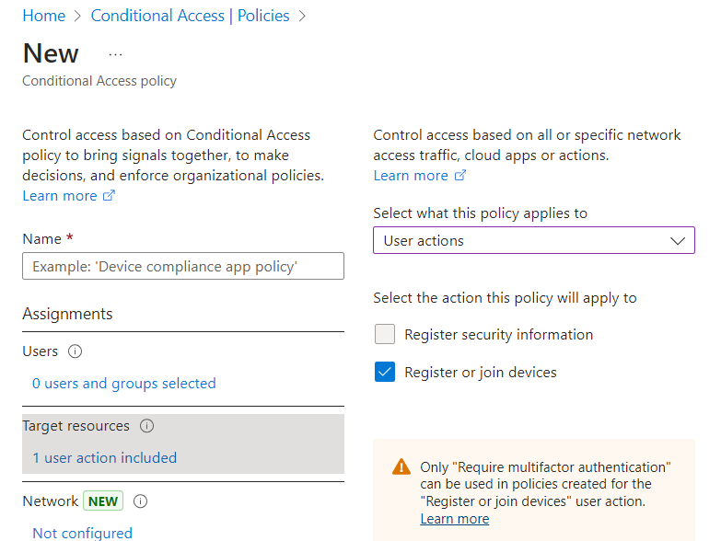
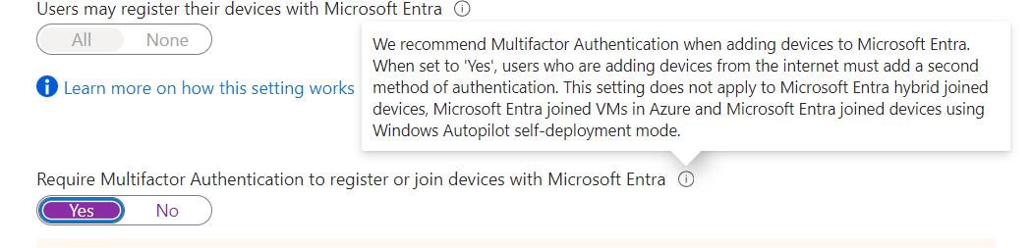
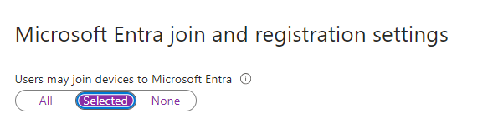
Conditional Access: Lock Down MFA registration/ Device Enrolment
Leverage device is MDM managed & compliant over fact it is just Entra Joined
Attacker may try to enrol device/MFA (or trick user into doing it for them)
Restrict Users from joining Devices to Entra / Intune
Consider Blocking MFA registration from non-approved locations and/or Block enrolling MFA unless company owned device
No block option for Registering devices “action” but can use phishing resistant Grant here
No need for separate Location based CA if already covered by a Location based CA targeting all apps
Also consider Intune enrolment restrictions (block personal MacOS/windows perhaps? Block Linux enrolment with CA targeting Microsoft Intune Enrolment as not an option in enrolment restriction: https://timmyit.com/2022/11/08/block-linux-enrollment-into-microsoft-intune-with-conditional-access/
A BYOD user device with Windows Hello can be used to bypass phishing-resistant auth strength – (Thanks Lewis Barry!) – Enrolment Restrictions/custom auth strengths
Legacy Option! – Migrate to conditional access for finer control:
Notes:
https://github.com/RedByte1337/GraphSpy - GraphSpy is popular tool for attackers to add MFA
Block Linux enrollment into Microsoft Intune with Conditional Access – TimmyIT.com
Could also “black hole” linux compliance policy
Can Restrict Fido keys with AAGUIDs. Use passkey explorer https://passkeydeveloper.github.io/passkey-authenticator-aaguids/explorer/?combined

Slide 39


MFA App: Show Location
Only really works if user is not prompt fatigued
Location not the most accurate, users may flag legitimate sign-ins as malicious. Residential proxy may be close enough to within reasonable doubt
Notes:
Wasn’t the default setting in my own tenant surprisingly

Slide 40

Newly Registered Domains
Finally, he stopped talking about conditional access….
Attackers are impatient and use newly registered domains so consider blocking
In Defender for endpoint this can be done with web content filtering (ensure network protection is enabled)
Microsoft defines Newly registered as domains registered in the past 30 days that have not yet been moved to another category.
Notes:
smartscreen

Slide 41



Abused TLDs (.zip, .top, .ru)
Ref: https://github.com/jkerai1/TLD-TABL-Block
Works At the DNS level
Drop any email containing the TLD as a URL inside the email
No TLD option for sender domains in TABL but you can use Exchange transport rule for this
Notes:
Firewall doesn’t work with DNS over HTTPs/TLS. You may be able to block TLDs in your DNS provider such as nextDNS
Block gTLD (.zip)/ FQDN domains with Windows Firewall and Defender for Endpoint (jeffreyappel.nl)

Slide 42



Typo squatting / Domain impersonation
Make sure users cannot override SmartScreen setting as this allows users to bypass Custom blocks
Aitm is already deceptive!
Attackers can take it further…
Ref: https://github.com/jkerai1/DNSTwistToMDEIOC
Notes:
Make sure users cannot override SmartScreen setting in windows settings – lives under App and Browser Control
Unticking Smartscreen for edge allows Edge to access the custom IOCs because they share the same service
DeviceEvents
| where (ActionType == "SmartScreenUrlWarning" and AdditionalFields.Experience == "CustomBlockList") or (AdditionalFields.ThreatName contains "EUS:Win32/Custom" and ActionType == "AntivirusDetection") or (AdditionalFields.ResponseCategory == "CustomBlockList" and ActionType == "ExploitGuardNetworkProtectionBlocked")
| join kind=leftouter DeviceFileCertificateInfo on SHA1
| join kind=leftouter IdentityInfo on $left.InitiatingProcessAccountUpn == $right.AccountUPN
| summarize by FileName, RemoteUrl,DeviceName, Signer, InitiatingProcessAccountUpn, InitiatingProcessFileName, SHA1,TimeGenerated, InitiatingProcessVersionInfoProductName, JobTitle

Slide 43



Guess it was DNS after all
Recon’ing domains attached to a tenant is trivial. Shoutout Dr Azure AD for his OSINT tool
DMARC all your domains (obvious?)
DMARC is not enabled by default for .onmicrosoft.com domains. SPF is set for you. DKIM can be done in defender portal.
Ref: https://aadinternals.com/osint/
https://aadinternals.com/osint/
Notes:
Emails sent to MOERA (.onmicrosoft.com) will look no different to end user, however you can see the difference in the raw EML,headers in MDO will look identical

Slide 44

Attackers love to abuse .onmicrosoft.com domains
Attacker spins up their own MSFT Tenant to send phishes
Use Exchange transport rule to quarantine malicious .onmicrosoft.com domains
Whitelist as required (“Except if”)
Block outgoing mail from your .onmicrosoft.com domain?
Received Emails routed through
victim’s MOERA (.onmicrosoft.com)
will look no different to end user
however, you can see the .onmicrosoft.com in the headers
(see Proxy address attribute in Entra for the routing
- may matter for third party email filters)
Ref: https://c7solutions.com/2024/04/blocking-onmicrosoft-com-emails-in-exchange-online-protection
1 2 3 4 5 6 7 8 9 | EmailEvents | where SenderFromDomain contains ".onmicrosoft.com" | where SenderFromDomain !contains "yourtenant.onmicrosoft.com" | where SenderFromDomain !contains "yourtenant.mail.onmicrosoft.com" | where SenderFromAddress !contains "postmaster" | where EmailDirection == "Inbound" | where DeliveryAction == "Delivered" | project SenderFromAddress, SenderFromDomain, SenderDisplayName, SenderMailFromAddress ,SenderMailFromDomain, Subject, DeliveryAction
Notes:
Consider parking .onmicrosoft domains (could be in a dev tenant) – think of what domains an attacker may use to trick an end user
Do NOT add domains in TABL in “allow”, bypasses all protections
Multiple ways to block .onmicrosoft.com mail – Exchange transport rule, option in EAC

Slide 45




Teams Pivoting/Initial Access
Unfortunately, much of Teams security is handled client side… (burp suite go brrrr)
Problem: External collaboration enabled for all domains by default – whitelist domains!
Make sure ZAP is enabled for Teams to prevent internal pivoting (at current doesn’t support External messages)
Ensure Teams Webhooks are also secured (i.e. make sure webhook URLs aren’t public, I’ve found webhook URLs in public facing front end before!). Use Key vault, pipeline secret variables, SecureString etc. (Novel take on Webhook phishing: https://www.blackhillsinfosec.com/wishing-webhook-phishing-in-teams)
Lock down Teams Channels being used as mailboxes (unlikely vector but worth mentioning)
Ref: https://labs.jumpsec.com/advisory-idor-in-microsoft-teams-allows-for-external-tenants-to-introduce-malware/
Also Restrict Email Auto forwarding domains too!
Notes:
Email Forwarding restrictions https://learn.microsoft.com/en-us/defender-office-365/outbound-spam-policies-external-email-forwarding?view=o365-worldwide

Slide 46

Breaking MFA boundary (not AiTM related but…)
Don’t let users potentially break MFA boundary by installing MFA applications on work machine
Don’t need to steal token if I can generate my own MFA codes once I have remote access!
Examples: WinAuth, LLDPlayer/BlueStacks/Nox (android emulators), authenticator.cc
Block using WDAC/AppLocker/Software Certificate in MDE as a block Indicator (cert larger scope than hash!!)
Smartscreen for apps/ASR Rules
Ref: https://github.com/jkerai1/SoftwareCertificates
Other windows credential hardening:
Deny users signing into Personal Browser profile
LAPS
LSA Protection (RunAsPPL)
Credential Guard
WDigest disable cleartext

Slide 47

Miscellaneous Stuff!
Attackers love setting up AiTM infrastructure on Cloudflare, worth warning users that Microsoft does not use Cloudflare for login page!
Consider Blocking/monitoring link shorteners (biolinky[.]co, bit[.]ly, drp[.]li)
Block cloudflare trial page if feasible (trycloudflare.com) – as well as cloudflare-ipfs.com (IPFS gateway) & workers.dev (Cloudflare workers)
https://github.com/netskopeoss/NetskopeThreatLabsIOCs/ - ingest as KQL Query!
Use a password manager, even if AiTM fails attacker can use the gained password to pivot to other services/legacy auth. Do not use store passwords in browser!
Attackers love encoding/encrypting usernames as URL parameters if they know who their target is*
Block IOCs at highest scope if possible, Params/lure/ sub domains can rotate.
Typical Evilgnix URL: <phishlet>.<attacker domain>.<TLD>/<lure>?encrypedParam
Notes:
https://www.linkedin.com/pulse/stealing-passwords-defender-endpoint-jay-kerai/
Heroku is another – can block in MDA
*Dynamically encrypted in evilgnix
let NetskopeCloudflareWorkers = externaldata(Url: string)[@"https://raw.githubusercontent.com/netskopeoss/NetskopeThreatLabsIOCs/main/Phishing/CloudflareWorkers/IOCs/README.md"] with (format="csv", ignoreFirstRecord=True); let CloudFlareWorkers = NetskopeCloudflareWorkers | where Url startswith "hxxp" | extend domain = split(Url,'/') | extend RemoteUrl = replace_string(strcat(domain[1],domain[2]),'[.]','.') //remove defang from externaldata | distinct RemoteUrl; //calling RemoteUrl makes doing joins easier 😉 DeviceNetworkEvents | where RemoteUrl in (CloudFlareWorkers) //example, use as you please

Slide 48
Important Note: Responding to AiTMs (1)
Revoke token only revokes refresh token! Access token unaffected
Many security teams do not have direct access to reset passwords
Confirm User Compromised does NOT revoke refresh token (however could trigger CAE but attacker may be outside of CAE as not all apps are supported)
The password Change itself does revoke token but cannot afford to wait for the user to hit the CA to change their password. (also recall MDI password reset only works if password expiry is enforced on-premise)
Make sure to revoke token AND password reset once AiTM is detected. Revoke token is privileged operation however using “Require User to Sign in Again” in MDA can get around this.
Even if Attacker does not successfully get in you should reset password regardless as you have no way of knowing if user put password in and attacker didn’t relay password back to Entra (broken AiTM phishlet?)
If Conditional Access was evaluated then you know attacker passed First factor i.e. password. Conditional access is NOT the first line of defence
Notes:
kql/aitmInvestigation.kql at main · jsa2/kql · GitHub
kql/impossibleTravelAdvancedHunting.kql at main · jsa2/kql · GitHub

Slide 49


Important Note: Responding to AiTMs (2)
Ensure attacker didn’t enrol their own device/MFA
Check for any inbox /mail forwarding rules an attacker may have placed.
Disabling OWA (Outlook Web App) is not a bad idea to slow down attacker (at least for VIPs?)
For obvious reasons “MFA completed in Azure” cannot be used as evidence to prove it’s the end user in AiTM scenario
Ensure to check Non-interactive logs too for AiTM to see what resources attacker created access tokens for and resources attacker may have accessed (Graph Logs?)
Notes:
Non-interactive logins: minimizing the blind spot - Microsoft Community Hub
Business Email Compromise Detection – ReliaQuest
Get-CASMailbox | Set-CASMailbox -OWAEnabled $false

Slide 50

Summary
Tokens are powerful for attackers & defending against them is complex (Tokens are like quantum mechanics, if you think you understand them you probably don’t, myself included)
Attackers are going to continuously evolve their tradecraft. AiTMs has only gotten better (AITM leveraging WAM & EvilPuppet from a compromised joined device perhaps?)
However basic principles remain the same
Conditional Access is EXTREMELY powerful but easy to misconfigure/leave gaps (Intune compliance + named locations is a strong starting point for defending token theft in general)
Defence in Depth – assume attacker will bypass some of the controls placed! (e.g User gonna user)
FIDO is great start but does not solve every problem on its own
Didn’t cover everything here, still more research to be done! (Possible Part 2: Illicit Consent Grant?, PRT Attacks?, Device Code flow/FOCI?, Multiple IdP abuse? Browser in the middle?, CBA / PKI, Auth Transfer flow abuse)
Notes:
GitHub - secureworks/family-of-client-ids-research: Research into Undocumented Behavior of Azure AD Refresh Tokens
Didn’t talk about Insider Risk CA or Disable persistent cookie; they aren’t necessarily going to stop AiTM
CBA can be setup as single or multifactor, CBA does help against AiTM in the same way as FIDO but Intune does the same thing for device trust. Intune + CBA could be an option though if you have existing PKI. With FIDO you cant revoke a key directly across providers but with PKI you can.

Slide 51


Thanking you Don’t worry there's no quiz
Notes:
References:
Slide 3: How to bypass MFA?
https://github.com/kgretzky/evilginx2
https://github.com/drk1wi/Modlishka
Smartscreen/Exploit Guard KQL:
DeviceEvents
| where ActionType == "SmartScreenUrlWarning" or ActionType == "ExploitGuardNetworkProtectionBlocked"
Browser history/Artificats: https://www.linkedin.com/pulse/stealing-passwords-defender-endpoint-jay-kerai
Slide 4:
Merill Fernado Demo: https://www.youtube.com/watch?v=tI1bdVohOK8
Slide 6: Simplyfing the attack
https://www.microsoft.com/en-us/security/blog/2022/07/12/from-cookie-theft-to-bec-attackers-use-aitm-phishing-sites-as-entry-point-to-further-financial-fraud/
Slide 8:
host locally: https://janbakker.tech/running-evilginx-3-0-on-windows/
Slide 12: Conditional Access: Sign-in Risk (Identity Protection)
Microsoft Entra ID Protection risk-based access policies - Microsoft Entra ID Protection | Microsoft Learn
Slide 13: On the same note…Idle Session Time Out
https://learn.microsoft.com/en-us/microsoft-365/admin/manage/idle-session-timeout-web-apps?view=o365-worldwide#details-about-idle-session-timeout
Slide 15: Conditional Access: Block Certain Device Platforms/User agents
Queries:
let OfficeHomeSessionIds =
AADSignInEventsBeta
| where Timestamp > ago(1d)
| where ErrorCode == 0
| where ApplicationId == "4765445b-32c6-49b0-83e6-1d93765276ca" //OfficeHome application
| where ClientAppUsed == "Browser"
| where LogonType has "interactiveUser"
| summarize arg_min(Timestamp, Country) by SessionId;
AADSignInEventsBeta
| where Timestamp > ago(1d)
| where ApplicationId != "4765445b-32c6-49b0-83e6-1d93765276ca"
| where ClientAppUsed == "Browser"
| project OtherTimestamp = Timestamp, Application, ApplicationId, AccountObjectId, AccountDisplayName, OtherCountry = Country, SessionId
| join OfficeHomeSessionIds on SessionId
| where OtherTimestamp > Timestamp and OtherCountry != Country
union SigninLogs , AADNonInteractiveUserSignInLogs
| where isnotempty(UserAgent)//| extend UserAgent = replace_string(UserAgent,";","")| where ResultType == "0"| extend UserAgentDetail = todynamic(parse_user_agent(UserAgent, dynamic(["browser","os","device"])))| extend OS = strcat(parse_json(tostring(UserAgentDetail.OperatingSystem)).Family," ",parse_json(tostring(UserAgentDetail.OperatingSystem)).MajorVersion,parse_json(tostring(UserAgentDetail. OperatingSystem)).MinorVersion)| extend UserAgentDetail = todynamic(parse_user_agent(UserAgent, "browser"))| extend UserAgentFamily = tostring(parse_json(tostring(UserAgentDetail.Browser)).Family)| extend UserAgentMajorVersion = toint(parse_json(tostring(UserAgentDetail.Browser)).MajorVersion)| extend UserAgentMinorVersion = toint(parse_json(tostring(UserAgentDetail.Browser)).MinorVersion)| where isnotempty(UserAgentMajorVersion)| extend UserAgentMinorVersion == iff(isempty(UserAgentMinorVersion),0,UserAgentMinorVersion)| summarize Count=count() by UserAgentFamily, UserAgentMajorVersion, UserAgentMinorVersion, OS| sort by Count
Slide 18: CAE
https://cloudbrothers.info/en/continuous-access-evaluation/
https://openid.net/specs/openid-sse-framework-1_0-01.html
Slide 19: Banned passwords
Tools
https://github.com/jkerai1/AzurePasswordProtectionCalculator
https://github.com/jkerai1/GeneratePasswordListFromWebsite
Sites:
https://exposed.lol/ (free)
https://leakpeek.com/
intelx.io
https://www.hudsonrock.com/
https://leakcheck.io/
Slide 20: PIM
https://jeffreyappel.nl/protect-against-aitm-mfa-phishing-attacks-using-microsoft-technology/
https://www.linkedin.com/posts/jay-kerai-cyber_entra-aitm-token-activity-7233084655942410240-e5zO
Slide 23: Attacker Controls the Proxy
https://github.com/nicolonsky/AzureAiTMFunction
Slide 24-28: Canary Token
https://didsomeoneclone.me/
https://www.linkedin.com/pulse/punishing-aitms-using-css-flask-jay-kerai-ffrhe/
Slide 31: FIDO
https://www.w3.org/TR/webauthn/#dictdef-tokenbinding
https://www.rfc-editor.org/rfc/rfc8471
https://www.silverfort.com/blog/using-mitm-to-bypass-fido2/
Slide 32-33: FIDO quirks
https://www.linkedin.com/pulse/passwordlessphishing-resistant-considerations-entra-jay-kerai-zh6nc
https://learn.microsoft.com/en-us/powershell/module/microsoft.graph.identity.signins/update-mgpolicyauthorizationpolicy?view=graph-powershell-1.0#-allowedtousesspr
Slide 34: PRT
https://learn.microsoft.com/en-us/entra/identity/devices/concept-primary-refresh-token
Slide 35: TPM/PRT
TPM Attest: https://youtu.be/j0D3So1q-IA?t=554
https://call4cloud.nl/2024/07/istpmattested-enrollment-attestation/
https://github.com/Cloud-Architekt/AzureAD-Attack-Defense/
Slide 37: CAE Demo
https://learn.microsoft.com/en-us/microsoft-365/enterprise/o365-data-locations?view=o365-worldwide
Slide 38: Conditional Access: Lock Down MFA registration/ Device Enrolment
https://timmyit.com/2022/11/08/block-linux-enrollment-into-microsoft-intune-with-conditional-access/
Can Restrict Fido keys with AAGUIDs. Use passkey explorer https://passkeydeveloper.github.io/passkey-authenticator-aaguids/explorer/?combined
https://github.com/RedByte1337/GraphSpy - GraphSpy is popular tool for attackers to add MFA
Slide 41: TLD Blocking
https://github.com/jkerai1/TLD-TABL-Block
https://jeffreyappel.nl/block-gtld-zip-fqdn-domains-with-windows-firewall-and-defender-for-endpoint/#:~:text=With%20the%20use%20of%20Defender
Slide 42: Typosquat
https://github.com/jkerai1/DNSTwistToMDEIOC
KQL:
DeviceEvents
| where (ActionType == "SmartScreenUrlWarning" and AdditionalFields.Experience == "CustomBlockList") or (AdditionalFields.ResponseCategory == "CustomBlockList" and ActionType == "ExploitGuardNetworkProtectionBlocked")
| join kind=leftouter DeviceFileCertificateInfo on SHA1
| join kind=leftouter IdentityInfo on $left.InitiatingProcessAccountUpn == $right.AccountUPN
| summarize by FileName, RemoteUrl,DeviceName, Signer, InitiatingProcessAccountUpn, InitiatingProcessFileName, SHA1,TimeGenerated, InitiatingProcessVersionInfoProductName, JobTitle
Slide 43: DNS OSINT
https://aadinternals.com/osint/
Slide 44: onmicrosoft
https://c7solutions.com/2024/04/blocking-onmicrosoft-com-emails-in-exchange-online-protection
Slide 45: Teams
https://labs.jumpsec.com/advisory-idor-in-microsoft-teams-allows-for-external-tenants-to-introduce-malware/
Novel take on Webhook phishing: https://www.blackhillsinfosec.com/wishing-webhook-phishing-in-teams)
Slide 46: MFA Boundary
https://github.com/jkerai1/SoftwareCertificates
Slide 47: Misc
browser passwords: https://www.linkedin.com/pulse/stealing-passwords-defender-endpoint-jay-kerai/
Netskope query:
let NetskopeCloudflareWorkers = externaldata(Url: string)[@"https://raw.githubusercontent.com/netskopeoss/NetskopeThreatLabsIOCs/main/Phishing/CloudflareWorkers/IOCs/README.md"] with (format="csv", ignoreFirstRecord=True);let CloudFlareWorkers = NetskopeCloudflareWorkers| where Url startswith "hxxp"| extend domain = split(Url,'/')| extend RemoteUrl = replace_string(strcat(domain[1],domain[2]),'[.]','.') //remove defang from externaldata| distinct RemoteUrl; //calling RemoteUrl makes doing joins easier 😉 DeviceNetworkEvents| where RemoteUrl in (CloudFlareWorkers) //example, use as you please
Typical Evilgnix URL: <phishlet>.<attacker domain>.<TLD>/<lure>?encrypedParam
Block Cloudflare domain post: https://www.linkedin.com/posts/jay-kerai-cyber_aitm-cloudflare-workers-activity-7225926416226263040-wCWW
link shorteners (biolinky[.]co, bit[.]ly, drp[.]li)
Slide 48: Responding to AITM
https://github.com/Bert-JanP/Hunting-Queries-Detection-Rules/blob/main/Azure%20Active%20Directory/PotentialAiTMPhishing.md
Slide 49: Responding (2)
https://techcommunity.microsoft.com/t5/microsoft-sentinel-blog/non-interactive-logins-minimizing-the-blind-spot/ba-p/2287932
PS command:
Get-CASMailbox | Set-CASMailbox -OWAEnabled $false

Slide 52

Appendix: Non-Persistent Browser Session
Cookie being cleared client side does NOT revoke server side
Attacker can keep copying token out of their proxy tool (recall demo)
But more fundamentally for reverse phishing to work, attacker MUST manipulate the cookie (or you accidentally send the cookie with the phishing referrer straight to Microsoft…d’oh)
Attacker can also manipulate whether cookie is stored in Local vs session storage
SIF uses authn time > outright a better control than non-persistent session?
SIF
Eval
Notes:
In persistent browsers, cookies stay stored in the user’s device even after a user closes the browser. These cookies could have access to Microsoft Entra artifacts, and those artifacts are useable until token expiration regardless of the Conditional Access policies placed on the resource environment. So, token caching can be in direct violation of desired security policies for authentication. While it might seem convenient to store tokens beyond the current session, doing so can create a security vulnerability by allowing unauthorized access to Microsoft Entra artifacts.
Evilginx will parse every occurrence of Set-Cookie in HTTP response headers and modify the domain, replacing it with the phishing one, as follows:
Set-Cookie: qwerty=219ffwef9w0f; Domain=our-phishing-site.com; Path=/;
Evilginx also sends its own cookies to manage the victim's session. These cookies are filtered out from every HTTP request, to prevent them from being sent to the destination website.

Slide 53
Appendix: Plenty of ways to Analyze Conditional Access Gaps
Blue Team Side:
Conditional Access Gap analyser workbook (learn.microsoft.com/en-us/entra/identity/monitoring-health/workbook-conditional-access-gap-analyzer)
Maester (maester.dev)
caOptics (github.com/jsa2/caOptics)
Red Team side:
TeamFiltration (github.com/Flangvik/TeamFiltration)
Other red team tools I like:
I also like graphspy
Roadtools
Tokentactics (particuraly Fabian Bader’s fork that includes CAE claim)
Notes:
I also like graphspy
Roadtools
Tokentactics

Slide 54


Appendix: MFA in Token
Ref: https://jwt.ms/

Slide 55

Appendix: Diagram View Of Attack
Ref: https://www.microsoft.com/en-us/security/blog/2023/06/08/detecting-and-mitigating-a-multi-stage-aitm-phishing-and-bec-campaign/

Slide 56



Appendix: Browser History Acquisition
<username>\AppData\Local\Google\Chrome\User Data\ Default
History file in “C:\users\<username>\AppData\Local\Google\Chrome\User Data\Default”
Open file with https://sqlitebrowser.org/dl/.
May be other profiles (Profile 1, Profile 2) so check those as well as Default
Ref: https://www.linkedin.com/pulse/stealing-passwords-defender-endpoint-jay-kerai

Slide 57
Appendix: Country Change KQL
While it can be defeated it is still worth detecting a change in user agent/change in country
let OfficeHomeSessionIds =
AADSignInEventsBeta
| where Timestamp > ago(1d)
| where ErrorCode == 0
| where ApplicationId == "4765445b-32c6-49b0-83e6-1d93765276ca" //OfficeHome application
| where ClientAppUsed == "Browser"
| where LogonType has "interactiveUser"
| summarize arg_min(Timestamp, Country) by SessionId;
AADSignInEventsBeta
| where Timestamp > ago(1d)
| where ApplicationId != "4765445b-32c6-49b0-83e6-1d93765276ca"
| where ClientAppUsed == "Browser"
| project OtherTimestamp = Timestamp, Application, ApplicationId, AccountObjectId, AccountDisplayName, OtherCountry = Country, SessionId
| join OfficeHomeSessionIds on SessionId
| where OtherTimestamp > Timestamp and OtherCountry != Country

Slide 58


Appendix: Host Evilginx Locally
Ref: https://janbakker.tech/running-evilginx-3-0-on-windows/

Slide 59

Appendix: Built in Detections That aren’t direct detections

Slide 60


Appendix: Punishing Attacker Trying to enrol their device
Ref: https://www.linkedin.com/pulse/poking-aitms-part-2-devfender-strikes-back-jay-kerai-i5nue/

Slide 61

Appendix: Right Orient Aitm Page
Notes:
Just to show orientation doesn’t matter, attacker can account for it

Slide 62

Appendix: Block Email Auto Forwarding

Slide 63

Appendix: Disable SSPR for Admins

Slide 64


Appendix: Oauth SSO
A refresh token must not allow the client to gain any access beyond the scope of the original grant. The refresh token exists to enable authorization servers to use short lifetimes for access tokens without needing to involve the user when the token expires.

Slide 65
Appendix: Modification of Cookies
Evilginx will parse every occurrence in HTTP response headers and modify the domain, replacing it with the phishing one, as follows:
Evilginx will parse every occurrence of Set-Cookie in HTTP response headers and modify the domain, replacing it with the phishing one, as follows:
Set-Cookie: qwerty=219ffwef9w0f; Domain=our-phishing-site.com; Path=/;
Evilginx also sends its own cookies to manage the victim's session. These cookies are filtered out from every HTTP request, to prevent them from being sent to the destination website.

Slide 66

Appendix: Evilginx HTTPS
Evilginx initiates its own HTTPS connection with the victim (using its own SSL/TLS certificates), receives and decrypts the packets, only to act as a client itself and establish its own HTTPS connection with the destination website, where it sends the re-encrypted packets, as if it was the victim's browser itself.
Evilginx will automatically obtain a valid SSL/TLS certificate from LetsEncrypt and provide responses to ACME challenges, using the in-built HTTP server.
This is how the trust chain is broken and the victim still sees that green lock icon next to the address bar, in the browser, thinking that everyone is safe.

Slide 67
Appendix: Evilginx Handling DNS
Evilginx now runs its own in-built DNS server, listening on port 53, which acts as a nameserver for your domain. All you need to do is set up the nameserver addresses for your domain (ns1.yourdomain.com and ns2.yourdomain.com) to point to your Evilginx server IP, in the admin panel of your domain hosting provider. Evilginx will handle the rest on its own.
Evilginx now runs its own in-built DNS server, listening on port 53, which acts as a nameserver for your domain.
All you need to do is set up the nameserver addresses for your domain (ns1.yourdomain.com and ns2.yourdomain.com) to point to your Evilginx server IP, in the admin panel of your domain hosting provider. Evilginx will handle the rest on its own.

Slide 68
Appendix: Modification of HTTP Headers
in HTTP response headers and modify the domain, replacing it with the phishing one, as follows:
Evilginx automatically changes Origin and Referer fields on-the-fly to their legitimate counterparts.
Evilginx makes sure to set the Access-Control-Allow-Origin header value to * (if it exists in the response) and removes any occurrences of Content-Security-Policy headers. This guarantees that no request will be restricted by the browser when AJAX requests are made.
Other header to modify is Location, which is set in HTTP 302 and 301 responses to redirect the browser to different location. Naturally the value will come with legitimate website URL and Evilginx makes sure this location is properly switched to corresponding phishing hostname.
Evilginx will parse every occurrence of Set-Cookie in HTTP response headers and modify the domain, replacing it with the phishing one, as follows:

Slide 69
Appendix: Hiding Phishlets
Evilginx will parse every occurrence in HTTP response headers and modify the domain, replacing it with the phishing one, as follows:
hide and unhide the phishing page whenever you want. Hidden phishing page will respond with a redirection 302 HTTP code
Ability to freeze lures
Tokenized phishing URLs, hide from public scanners
When tokenized URL is opened, Evilginx sets a validation cookie in victim's browser, whitelisting all subsequent requests, even for the non-tokenized ones.
https://breakdev.org/evilginx-2-next-generation-of-phishing-2fa-tokens/

Slide 70

Appendix: Window.location
Dirty simple harden but can be beaten with sub_filters (unless you heavily obfuscate your JS but needs to be dynamic spoofing to reduce chance of successful phish)
Notes:
https://www.youtube.com/watch?v=C-Fh4sIdY8c

Slide 71

Appendix: Even yubikey was defeated once
https://www.wired.com/story/chrome-yubikey-phishing-webusb/

Slide 72
Appendix: ID Token
https://learn.microsoft.com/en-us/entra/identity-platform/id-tokens
ID tokens are a type of security token that serves as proof of authentication, confirming that a user is successfully authenticated. Information in ID tokens enables the client to verify that a user is who they claim to be, similar to name tags at a conference. The authorization server issues ID tokens that contain claims that carry information about the user. They can be sent alongside or instead of an access token, and are always JWT (JSON Web Token) format.
ID tokens differ from access tokens, which serve as proof of authorization. Confidential clients should validate ID tokens. You shouldn't use an ID token to call an API.

Slide 73

Appendix: John Savill’s whiteboard
Protecting Against Credential and Token Theft (youtube.com)
Great video and a good complement to this presentation

Slide 74

Appendix: Token Bind in W3 spec
https://www.w3.org/TR/webauthn/#dictdef-tokenbinding
https://datatracker.ietf.org/doc/html/rfc8471#section-1
Upon Client-Server Hello, a Token Binding extension is available.
The two endpoints agree on TLS fields that the client will sign.
Exactly like in WebAuthn, the browser creates a long-lived private/public keypair.
The client sends the public key to the RP for signature verification; then the signature is sent over the application layer.
The server verifies the signature and binds it to the session token.

Slide 75

Appendix: Token Bind Microsoft
https://www.silverfort.com/blog/using-mitm-to-bypass-fido2/

Slide 76

Appendix: Token Revocation

Slide 77

Appendix: Token Lifetimes

Slide 78
Appendix: Access Tokens and SIF
Organizations that use Conditional Access sign-in frequency (SIF) to enforce how frequently sign-ins occur can't override default access token lifetime variation. When organizations use SIF, the time between credential prompts for a client is the token lifetime that ranges from 60 - 90 minutes plus the sign-in frequency interval.
Let's say an organization sets sign-in frequency to occur every hour. When the token has lifetime ranging from 60-90 minutes due to token lifetime variation, the actual sign-in interval occurs anywhere between 1 hour to 2.5 hours.
If a user with a token with a one hour lifetime performs an interactive sign-in at 59 minutes, there's no credential prompt because the sign-in is below the SIF threshold. If a new token has a lifetime of 90 minutes, the user wouldn't see a credential prompt for another hour and a half. During a silent renewal attempt, Microsoft Entra ID requires a credential prompt because the total session length has exceeded the sign-in frequency setting of 1 hour. In this example, the time difference between credential prompts due to the SIF interval and token lifetime variation would be 2.5 hours.
https://learn.microsoft.com/en-us/entra/identity-platform/access-tokens#token-lifetime

Slide 79
Appendix: PRT issuance
During device registration, the dsreg component generates two sets of cryptographic key pairs:
Device key (dkpub/dkpriv)
Transport key (tkpub/tkpriv)
The private keys are bound to the device's TPM if the device has a valid and functioning TPM, while the public keys are sent to Microsoft Entra ID during the device registration process. These keys are used to validate the device state during PRT requests.
The PRT is issued during user authentication on a Windows 10 or newer device in two scenarios:
Microsoft Entra joined or Microsoft Entra hybrid joined: A PRT is issued during Windows logon when a user signs in with their organization credentials. A PRT is issued with all Windows 10 or newer supported credentials, for example, password and Windows Hello for Business. In this scenario, Microsoft Entra CloudAP plugin is the primary authority for the PRT.

Slide 80

Appendix: How is PRT Protected

Slide 81

Appendix: PRT Renewal

Slide 82
Appendix: Non-interactive Sign-in logs
Non-interactive user sign-ins are sign-ins that were performed by a client app or an OS component on behalf of a user. Like interactive user sign-ins, these sign-ins are done on behalf of a user. Unlike interactive user sign-ins, these sign-ins do not require the user to supply an Authentication factor. Instead, the device or client app uses a token or code to authenticate or access a resource on behalf of a user. In general, the user will perceive these sign-ins as happening in the background of the user’s activity.
Some activity that is captured in these logs:
A client app uses an OAuth 2.0 refresh token to get an access token.
A client uses an OAuth 2.0 authorization code to get an access token and refresh token.
A user performs single sign-on (SSO) to a web or Windows app on an Azure AD joined PC.
A user signs in to a second Microsoft Office app while they have a session on a mobile device using FOCI (Family of Client IDs).
https://techcommunity.microsoft.com/t5/microsoft-sentinel-blog/non-interactive-logins-minimizing-the-blind-spot/ba-p/2287932

Slide 83

Appendix: My Apps Scope

Slide 84
Appendix: How does PRT get an MFA Claim?
When an MFA-based PRT is used to request tokens for applications, the MFA claim is transferred to those app tokens. This functionality provides a seamless experience to users by preventing MFA challenge for every app that requires it. A PRT can get an MFA claim in the following ways:
Sign in with Windows Hello for Business: Windows Hello for Business replaces passwords and uses cryptographic keys to provide strong two-factor authentication. Windows Hello for Business is specific to a user on a device, and itself requires MFA to provision. When a user logs in with Windows Hello for Business, the user's PRT gets an MFA claim. This scenario also applies to users logging in with smart cards if smart card authentication produces an MFA claim from AD FS.
As Windows Hello for Business is considered multifactor authentication, the MFA claim is updated when the PRT itself is refreshed, so the MFA duration will continually extend when users sign in with Windows Hello for Business.
MFA during WAM interactive sign in: During a token request through WAM, if a user is required to do MFA to access the app, the PRT that is renewed during this interaction is imprinted with an MFA claim.
In this case, the MFA claim isn't updated continuously, so the MFA duration is based on the lifetime set on the directory.
When a previous existing PRT and RT are used for access to an app, the PRT and RT are regarded as the first proof of authentication. A new RT is required with a second proof and an imprinted MFA claim. This process also issues a new PRT and RT.
Windows 10 or newer maintain a partitioned list of PRTs for each credential. So, there's a PRT for each of Windows Hello for Business, password, or smart card. This partitioning ensures that MFA claims are isolated based on the credential used, and not mixed up during token requests.
Notes:
Primary Refresh Token (PRT) and Microsoft Entra ID - Microsoft Entra ID | Microsoft Learn

Slide 85

Appendix: OAuth 2.0 - Refresh Token and Rotation (1)

Slide 86

Appendix: OAuth 2.0 - Refresh Token and Rotation (2)

Slide 87

Appendix: CAE Abuse

Slide 88

Appendix: SIF Evaluation
Go Back
Notes:
Conditional Access adaptive session lifetime policies - Microsoft Entra ID | Microsoft Learn
User sign-in frequency and device identities
On Microsoft Entra joined and Microsoft Entra hybrid joined devices, unlocking the device, or signing in interactively refreshes the Primary Refresh Token (PRT) every 4 hours. The last refresh timestamp recorded for the PRT compared with the current timestamp must be within the time allotted in SIF policy for the PRT to satisfy SIF and grant access to a PRT that has an existing MFA claim. On Microsoft Entra registered devices, unlock/sign-in wouldn't satisfy the SIF policy because the user isn't accessing a Microsoft Entra registered device via a Microsoft Entra account. However, the Microsoft Entra WAM plugin can refresh a PRT during native application authentication using WAM.

Slide 89

Appendix: Tokens on Managed Windows hosts

Slide 90
Appendix: PRT Response Decoded
Stealing and faking Azure AD device identities (aadinternals.com)

Slide 91
Appendix: Netskope IOC KQL
let NetskopeCloudflareWorkers = externaldata(Url: string)[@"https://raw.githubusercontent.com/netskopeoss/NetskopeThreatLabsIOCs/main/Phishing/CloudflareWorkers/IOCs/README.md"] with (format="csv", ignoreFirstRecord=True); let DomainList = NetskopeCloudflareWorkers | where Url <> "```text" | where Url <> "- **URLs**" | where Url <> "```" | extend domain = split(Url,'/') | extend domain = split(domain,'.') | extend url = strcat(domain[1],domain[2]) | extend RemoteUrl = replace_string(url,'[.]','.') | project domain; DeviceNetworkEvents | where RemoteUrl in (DomainList)

Slide 92

Appendix: TPM Compliance
https://github.com/Cloud-Architekt/AzureAD-Attack-Defense/
MDM TPM Attest, block enrolment for devices that cannot attest TPM (enrolment restriction)
Use Filter to Create Enrolment Restriction
https://call4cloud.nl/2024/07/istpmattested-enrollment-attestation/
Notes:
https://youtu.be/j0D3So1q-IA?t=554

Slide 93

Appendix: Browser in the middle (BiTM)
Never seen one in the wild
Two types I can think of: web streaming another PC and fake browser window
Most of previous principles apply to both, notably though CSS warning is entirely defeated
Web Stream will likely use WebRTC , not worth blocking webrtc IMO
Fake Browser windows can give itself away if it doesn’t sniff user’s theme (e.g. light mode window on dark mode browser).
Instant give away of Fake browser window is the fact you won’t be able to drag the “window” outside of the browser
Notes:
https://www.youtube.com/watch?v=ntS7WHaznjI

Slide 94

Appendix: Cloudflare Telegram Shop
Bring your own Domain, Cloudflare account with API Key and zone ID

Slide 95

Appendix: FOCI - Family of Client IDs
FOCI was designed to support pseudo single sign-on (SSO) functionality for Microsoft mobile applications. FOCI mirrors the behavior of mobile operating systems that store authentication artifacts (such as refresh tokens) in a shared token cache with other applications from the same software publisher.
Notes:
https://github.com/secureworks/family-of-client-ids-research?tab=readme-ov-file#abusing-single-sign-on

Slide 96
Appendix: MRRT Token
Microsoft bent the rules of oauth2
In Oauth2 spec “Refresh tokens should only be able “to obtain access tokens with identical or narrower scope” as the original authorization”
MRRTs acted as “the OAuth2 equivalent of ticket granting tickets (TGTs) in Kerberos; they are artifacts that allow a user to obtain tokens to access resources the directory decides she or he has access to.
Refresh tokens are bound to a combination of user and client, but aren't tied to a resource or tenant… a client can use a refresh token to acquire access tokens across any combination of resource and tenant where it has permission to do so.”
https://www.cloudidentity.com/blog/2013/10/14/adal-windows-azure-ad-and-multi-resource-refresh-tokens/

Slide 97

Appendix: Access token in a nutshell

Slide 98

Appendix: Refresh Token Imprinted/cached Identifiers
https://cloudbrothers.info/continuous-access-evaluation/#refresh-token

Slide 99

Appendix: AMR claim property
WhFB is a RSA claim NOT a FIDO Claim

Slide 100

Appendix: Joined Vs registered vs Hybrid join

Slide 101

Appendix: MDM Enrollment Process (Device ID)

